Slide 1
MGM Resorts
Levi Lawson-James Humphreys

Slide 2
About MGM Resorts
Company owns more than 30 hotels, casinos, and golf courses across the globe
Total revenue for 2023 was over 15 billion dollars, with a net income of over 1 billion.
Resort locations in the US: Las Vegas, Maryland, Massachusetts, Michigan, New Jersey, and Ohio
Popular resorts/casinos in Las Vegas include the Bellagio, MGM Grand, and Mandalay Bay

Slide 3
Prior to 2023 breach
MGM Resorts was already the victim of a breach in 2019, resulting in the data of over 10 million customers being shared in a hacker forum, and a class-action lawsuit
The same year, they began using AWS re:Inforce, an IaaS, for help with securing their data

Slide 4
2023
Detected on September 10th
One day after detection, MGM put out a statement that acknowledging that a "cyber security incident" had affected some of their systems
Attack was claimed by hacker group Scattered Spider. Experts believe Scattered Spider collaborated with ALPHV to carry out their attack
Scattered Spider is notorious for its expertise in social engineering attacks, in this case the method used was vishing
ALPHV, also known as BlackCat, provides RaaS (Ransomware as a Service)

Slide 5
2023
Three days prior to the attack, Caesar's Entertainment was also the target of a cyber attack by the same group. They paid $15 million of the $30 million ransom to Scattered Spider
8 days after the attack on MGM, OKTA confirmed that 5 of its clients, including MGM Resorts and Caesar Entertainment, had been breached since August. The names of all companies attacked were not disclosed, but were allegedly within the manufacturing, retail, and technology sectors.

Slide 6
2023
Scattered Spider used LinkedIn to gather information about current employees
Using this information, they called the help desk for assistance logging into "their" accounts
These accounts allowed the hackers administrative privileges to MGM's Okta and Azure tenant environments
In order to maintain access in case of detection, Scattered Spider established a secondary identity provider (IDP) which submitted authenticated requests to Okta
This was confirmed by David Bradbury, Okta's chief security officer

Slide 7
2023
MGM's security team noticed unusual activity and began to shut down Okta Sync servers and other key infrastructure components in an attempt to prevent escalation of the attack
With the remaining access, the attackers employed ransomware to over 100 hypervisors in the network
MGM, unlike Caesar's Entertainment, decided not to pay the ransom

Slide 8
2023
MGM shut some systems down for 10 days in response
Customers were unable to make credit card transactions or use ATMs, and some reported they were unable to enter hotel rooms
After the breach, MGM spent roughly 10 million on IT consulting services and legal fees
MGM stated that no bank account numbers or payment card information was stolen; however, hackers were able to obtain a wealth of personal information including names, driver's license numbers, social security numbers, and passport numbers

Slide 9
Timeline for MGM 2023 Breach
September 7th - The attack occurred no later than September 7th with the group most likely scouting the company beforehand
September 11th –MGM takes some of their systems offline and their websites are down
September 11th – MGM puts out a statement saying that a cyber security incident has occurred it
September 11th – It was also determined later that customer and employee information was attained on this day
September 12th – Guest start to file complaints about booking and MGM’s website being down
September 14th – ALPHV puts out a statement pertaining to the MGM breach

Slide 10
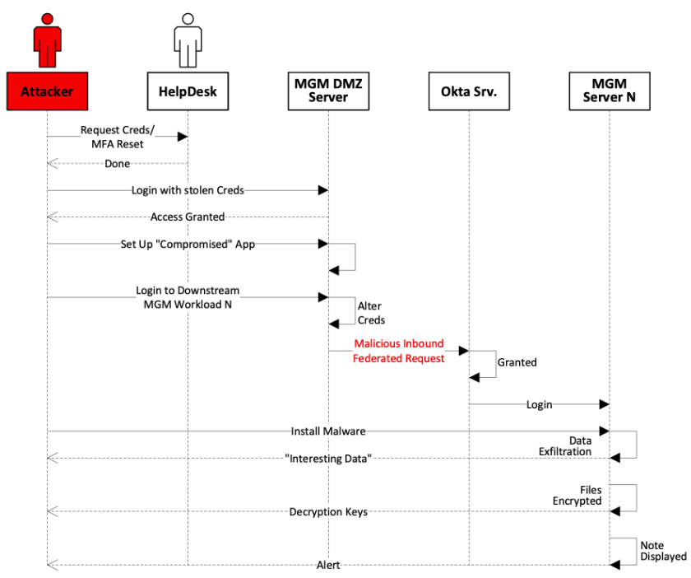

Slide 11
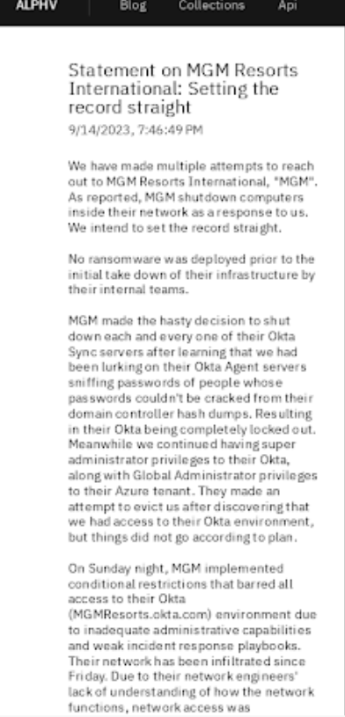
Statements

Slide 12
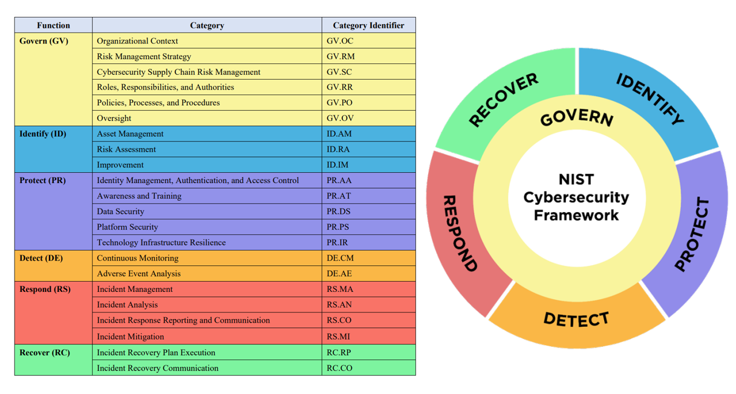
Nist Framework 2.0

Slide 13
Nuclei

Slide 14
NMAP

Slide 15
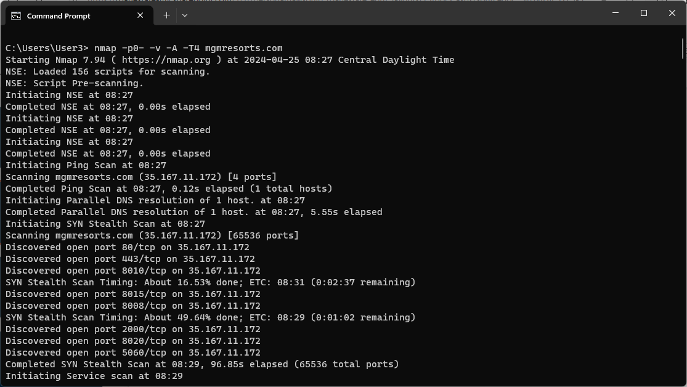
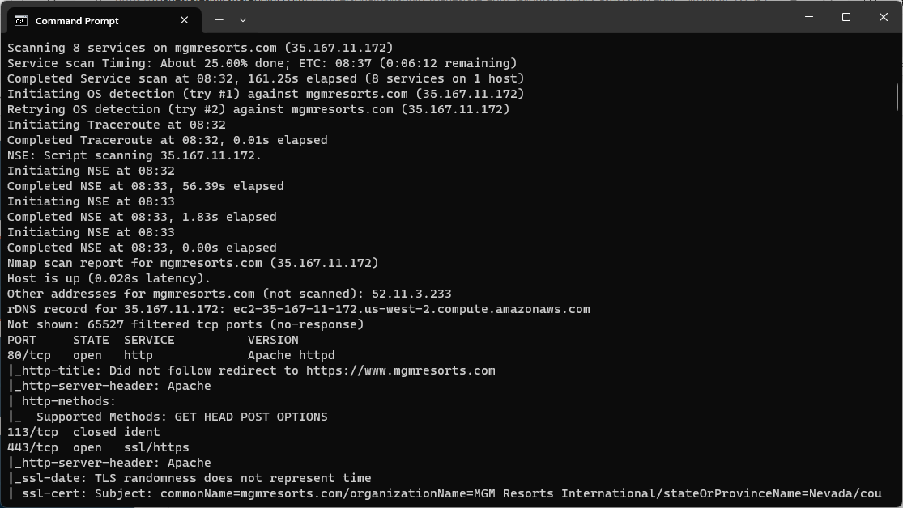

Slide 16
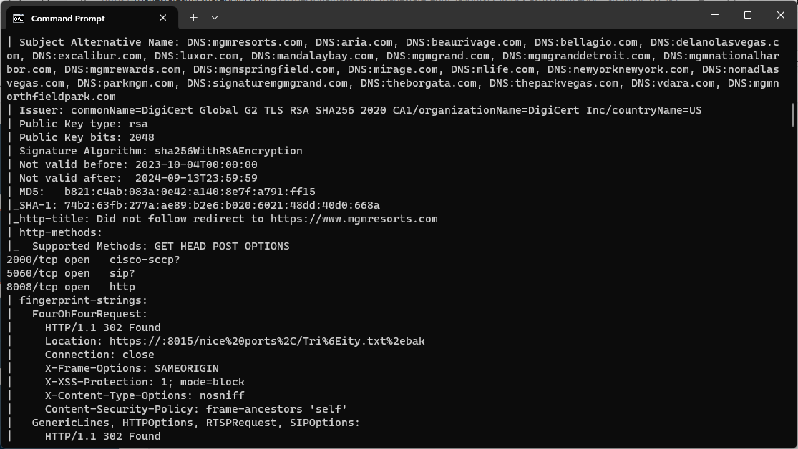
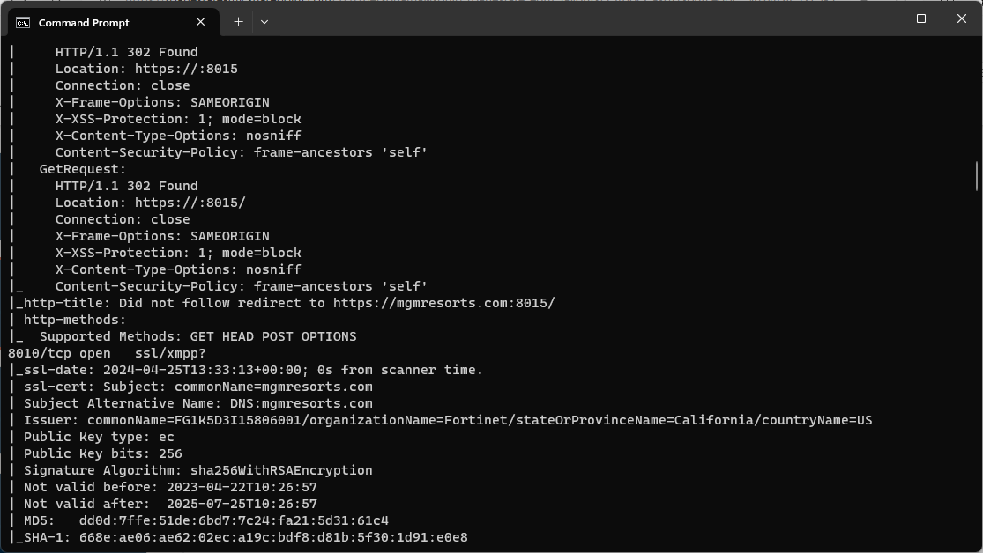

Slide 17
Zenmap

Slide 18
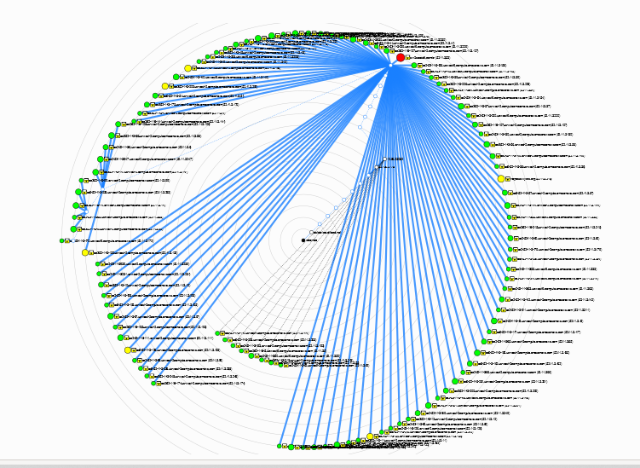

Slide 19
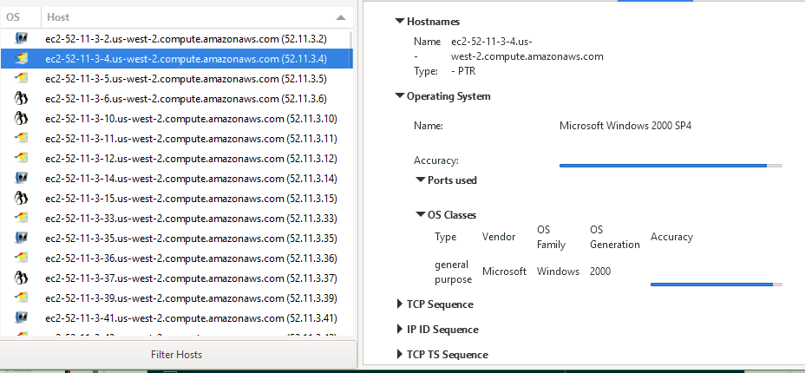

Slide 20
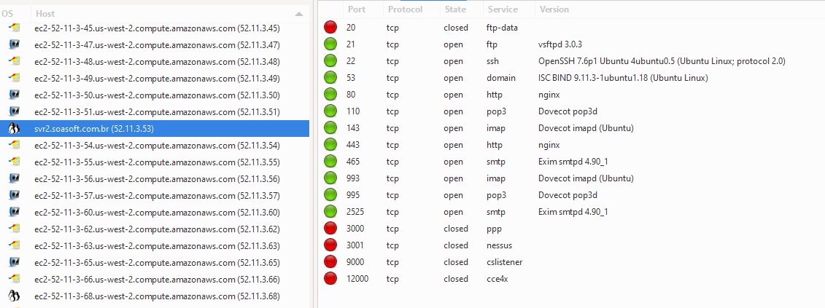

Slide 22
AMASS

Slide 23
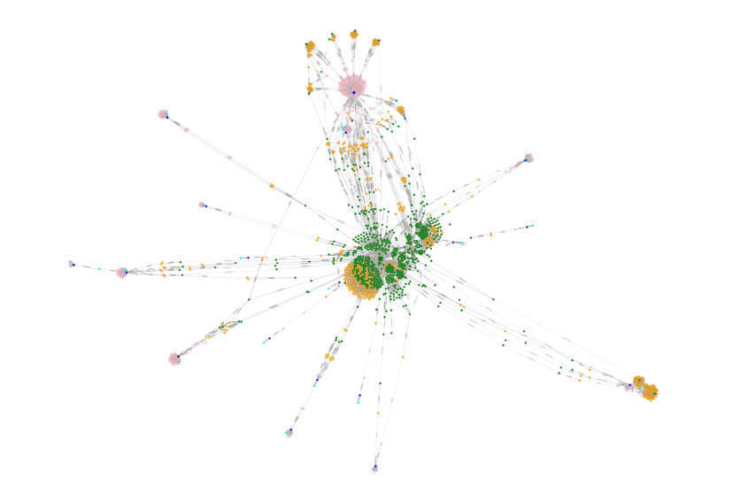

Slide 24
SSL Labs

Slide 25
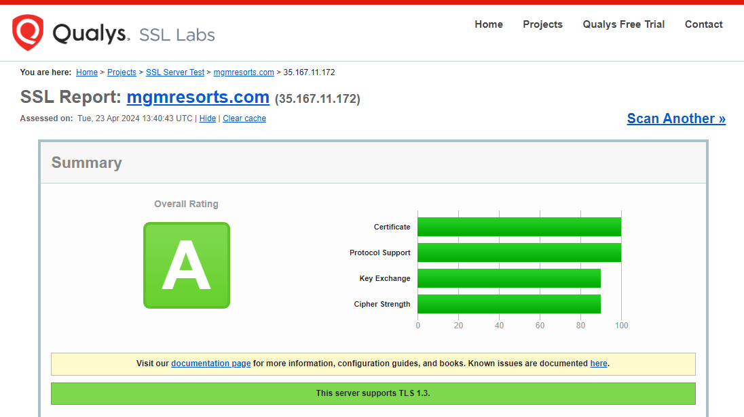
SSLLABS

Slide 26
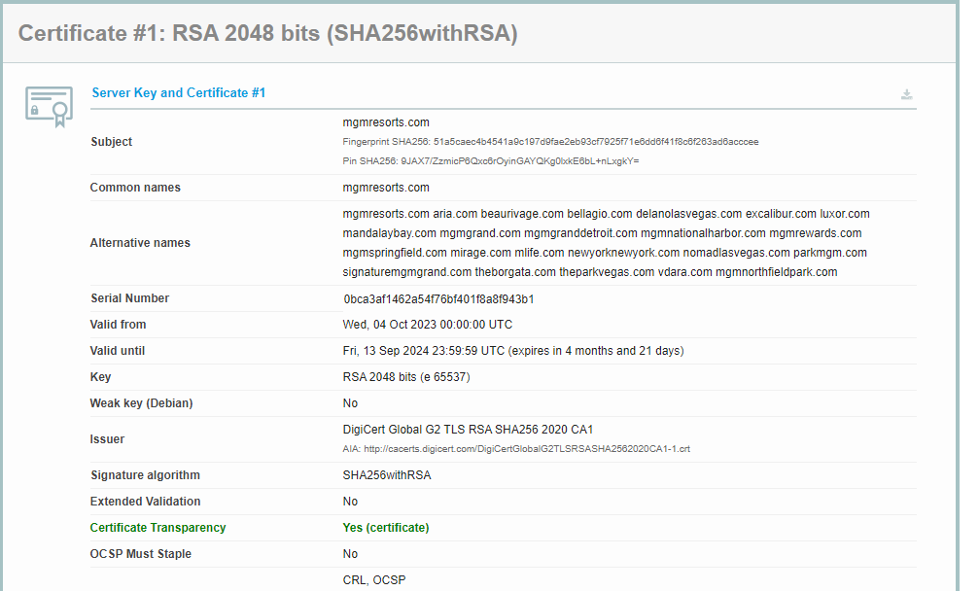

Slide 27
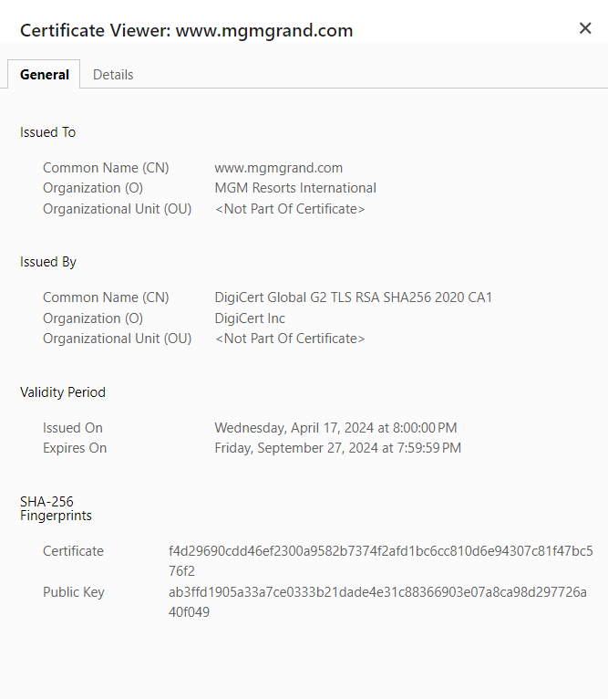
Certificate

Slide 28
Sucuri

Slide 29
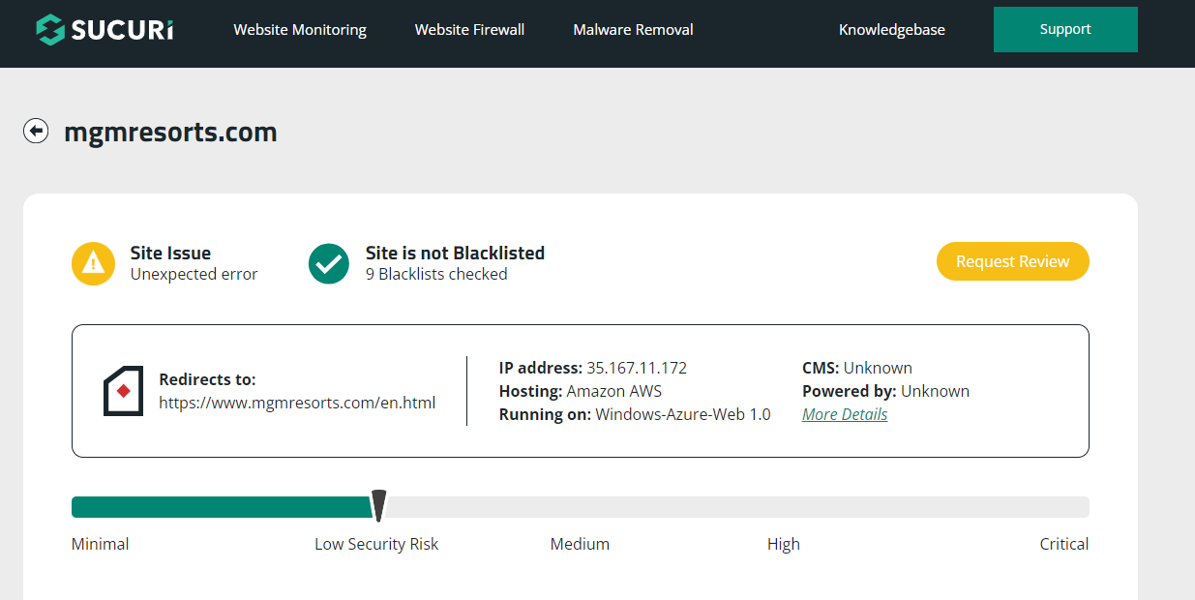
SUCURI

Slide 30
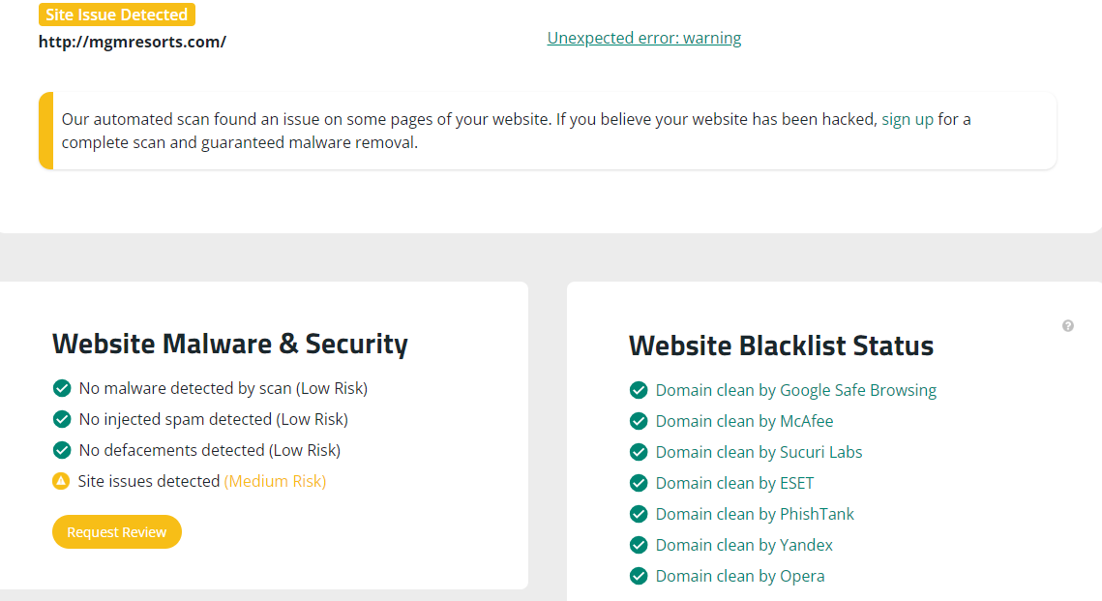

Slide 32
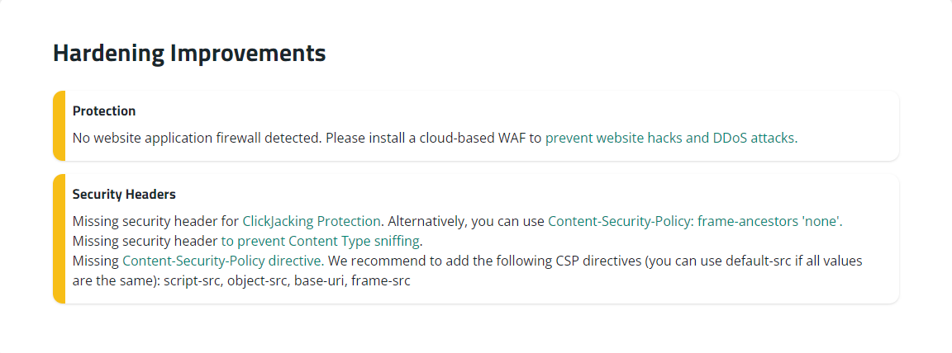

Slide 33
dnstwist

Slide 34
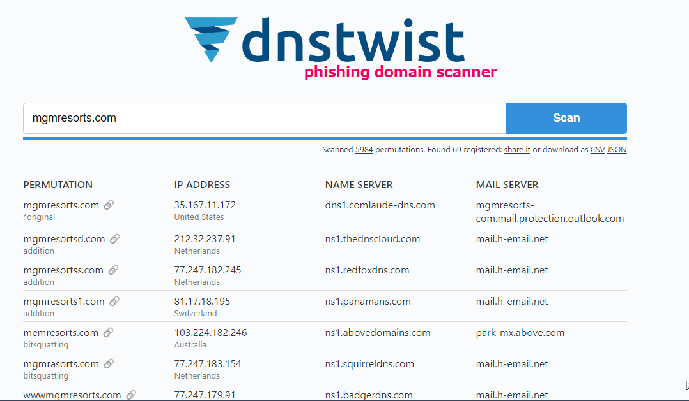

Slide 35
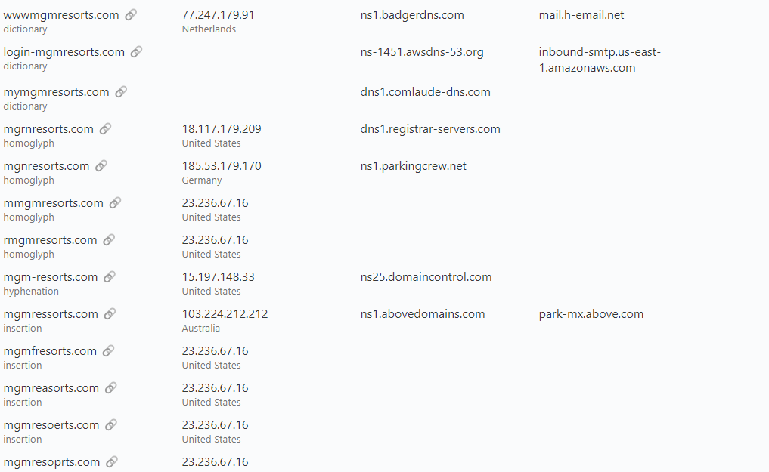

Slide 36
dnsdumpster

Slide 37
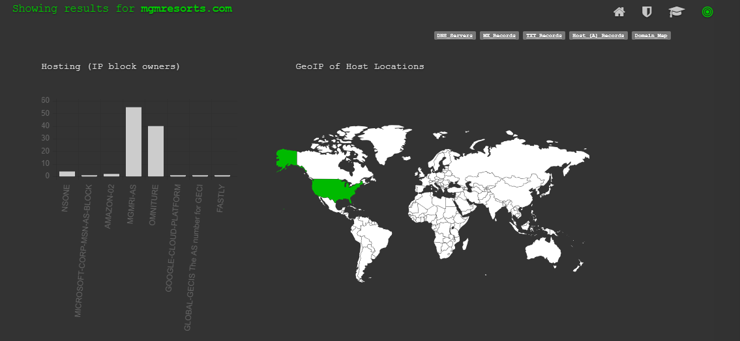

Slide 39
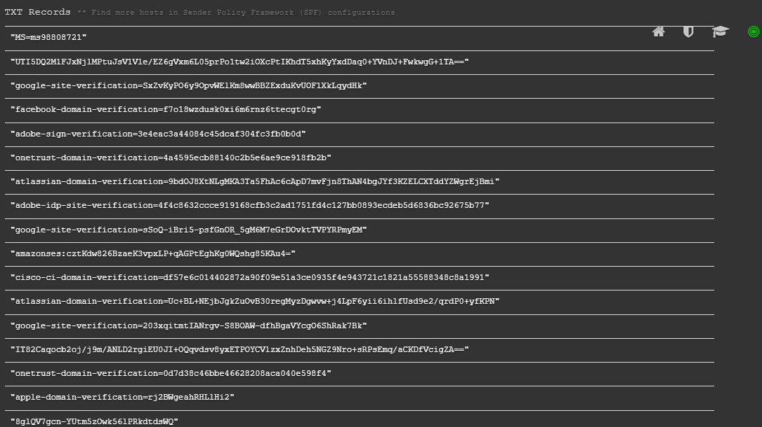

Slide 40
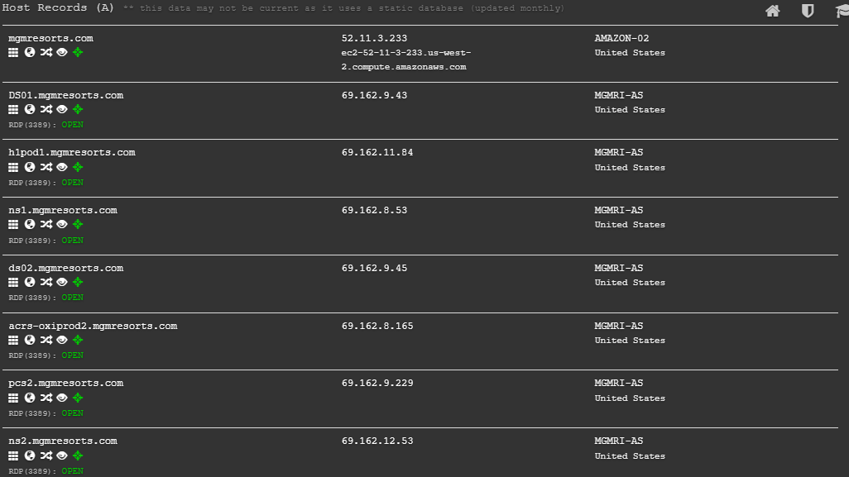

Slide 41
Sources
https://www.cshub.com/attacks/news/a-full-timeline-of-the-mgm-resorts-cyber-attack
https://thrivedx.com/resources/article/investigating-the-mgm-cyberattack-how-social-engineering-and-a-help-desk-put-the-whole-strip-at-risk
https://inszoneinsurance.com/blog/cyberattack-mgm-resort-explained
https://westoahu.hawaii.edu/cyber/global-weekly-exec-summary/alphv-hackers-reveal-details-of-mgm-cyber-attack/
https://industrial-software.com/community/news/in-depth-analysis-of-the-2023-mgm-resorts-cyberattack-virsec-systems-blog/
https://www.youtube.com/watch?v=HY5ZGLm6I1s

