Slide 1
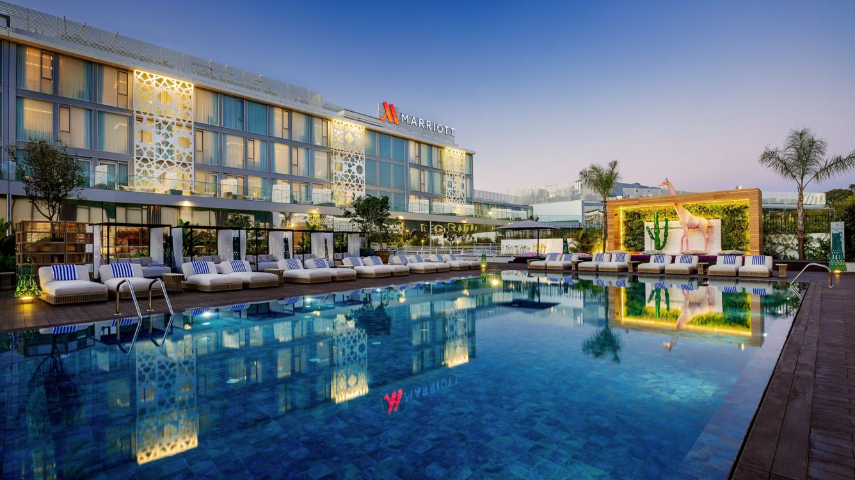
Marriott Data Breach 2018
CITC-1351 Principles of Information Assurance
Project by Sara Mattingly & Matt Julian
May 2nd, 2024
Rabat Marriott Hotel- Rabat, Morocco

Slide 2
Outline
Marriott & Starwood Introduction and History
Breach Timeline
NIST Cybersecurity Framework Analyzation
Common Vulnerabilities- Nuclei
Marriott Zenmap Report
AMASS Threat Landscape
Conclusions
Breach Overview
Website Analyzation
Breach Impact

Slide 3
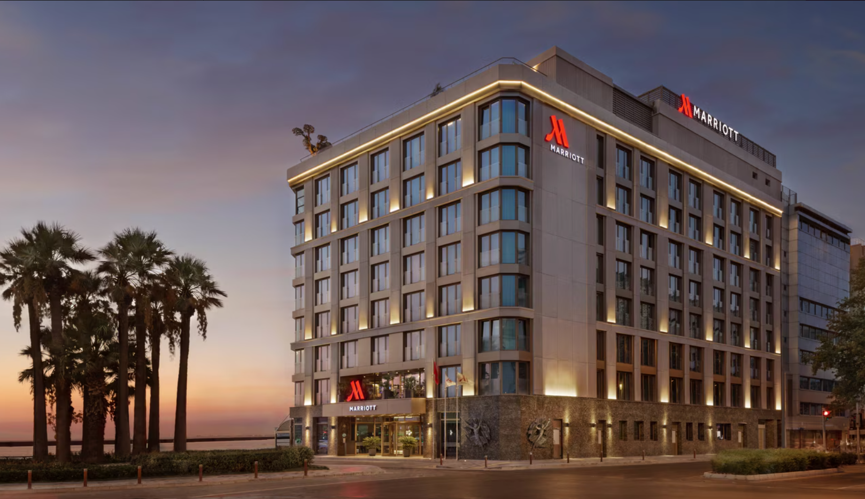
Marriott, International
Founded 97 years ago, May 1927, in Washington, D.C.
Manages over 8,500 properties worldwide
Generated $23 billion in revenue in 2023
Headquartered in Bethesda, Maryland
Operates 30 brands in total including well known brands such as The Ritz-Carlton, Sheraton Hotels & Resorts, and Westin Hotels & Resorts
Izmir Marriott Hotel

Slide 4
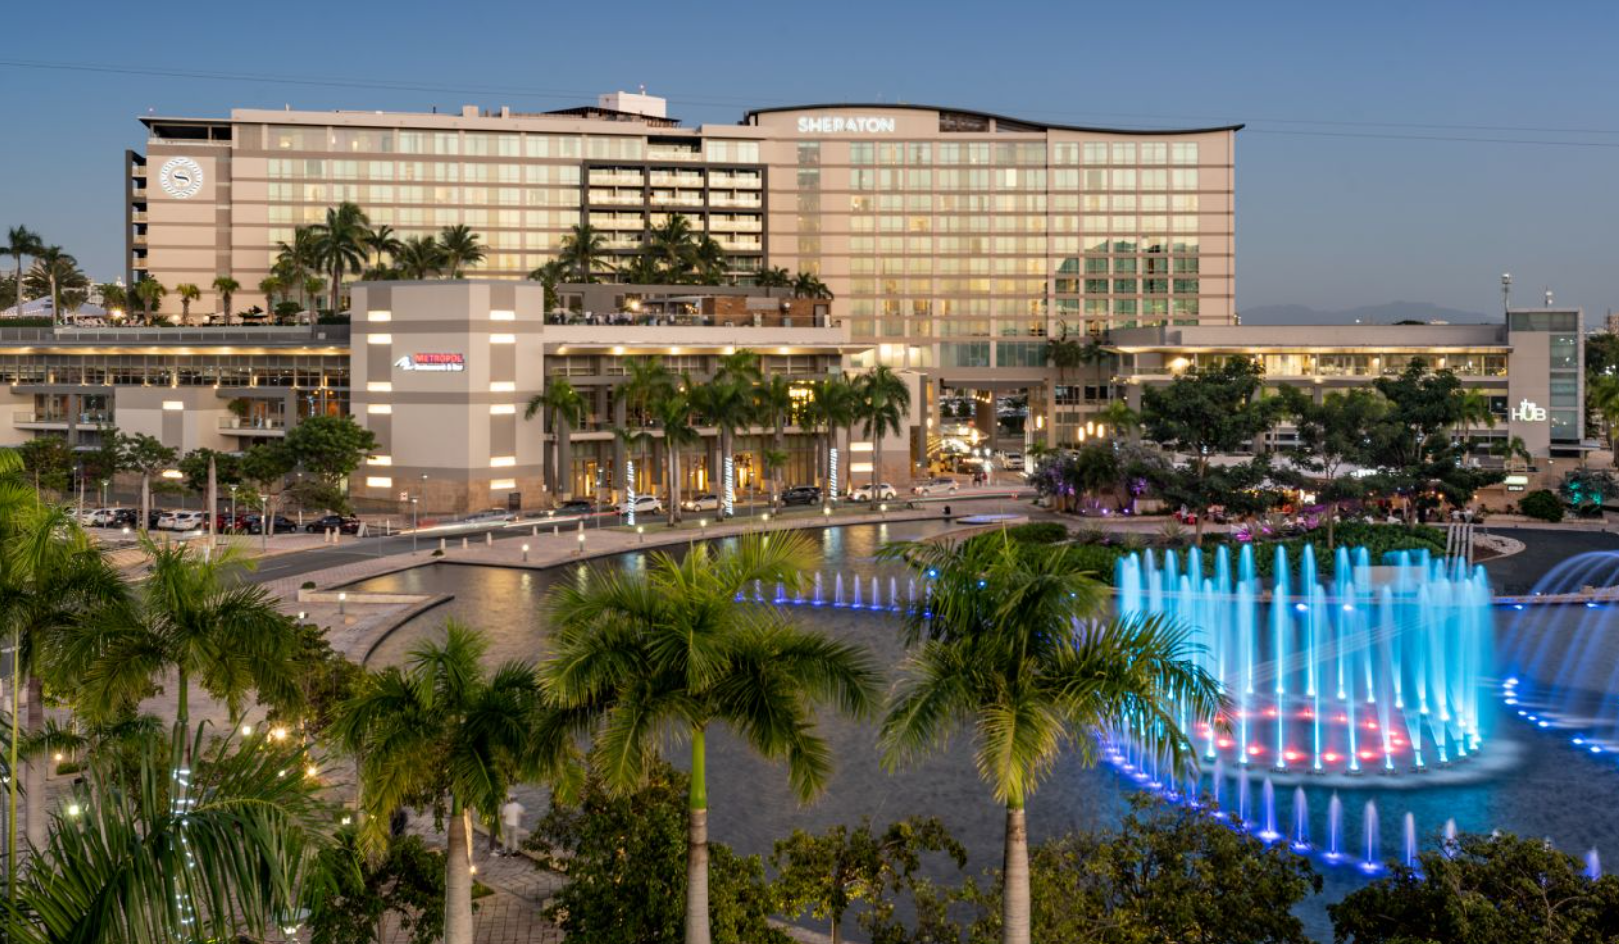
Starwood Hotels & Resorts
Founded in 1969
Starwood had 11 brands and owned, managed, or franchised 1,297 properties comprising 370,000 hotel rooms in approximately 100 countries.
Starwood brands included St. Regis, W Hotels, Sheraton, Aloft among many others.
Sheraton Puerto Rico Resort & Casino

Slide 5
Breach Overview
Marriott released a statement on November 30, 2018
500 million guests’ information compromised
Breach affected data from Starwood, a company acquired by Marriott in 2016
Information included names, addresses, phone numbers, email addresses, passport numbers, and credit card numbers.

Slide 6
Starwood Hotels & Resorts
Marriott acquired Starwood in Sept. 2016
No detailed cybersecurity audit of Starwood’s networks prior to acquisition
Starwood allowed to use compromised system following acquisition

Slide 7
How The Breach Occurred
Successful social engineering allowed physical access to a workplace machine
Network & Internet Connections
Remote Access Trojan (RAT)
Granted root-level permissions on the impacted machine & network-adjacent machines
MimiKatz was used to acquire passwords & hashes

Slide 8
Why the Breach Occurred
Marriott is the largest hotel provider to the US government & military
Attack likely carried out by China’s Ministry of State Security
Personal info (passport numbers, etc.) could be used to track people’s movements and identify targets
Other similar, likely related attacks took place around the same time

Slide 9
Immediate Consequences
Marriott establishes 24-hour multi-national call center related to the breach
Provide 1 year’s access to security monitoring software WebWatcher
NY Attorney General announces an investigation into the breach
Multiple European regulators announce investigations into the breach

Slide 10
Further Consequences for Marriott
Fined $120 million by Britain’s Information Commissioner’s Office for violation of the General Data Protection Regulation
Multiple class action lawsuits filed in US and Canada
$12.5 billion requested in damages by one lawsuit, equalling $25 for every impacted customer
Marriott’s reputation is damaged, with an estimate of $1 billion given as the financial cost of this damage

Slide 11
Marriott’s Failures During Acquisition
Insufficient monitoring of privileged accounts within its networks
Failed to implement activity monitoring on workplace machines
Failed to monitor databases for data integrity
Failed to take basic steps such as server hardening
Failed to complete a detailed cybersecurity audit of Starwood’s networks and technology prior to acquiting the company

Slide 12
Marriott’s Failures Following Acquisition
Marriott allowed Starwood to continue utilizing the guest reservation system
Failed to implement company-wide, standardized protocols & security policy
(2016) Marriott begins migrating customer information from Starwood databases

Slide 13
Financial Consequences
estimated $30 million in overall recovery costs
estimated $1 billion in lost revenue due to reputational damage
$120 million fine from British Information Commissioner’s Office
several class-action lawsuits filed in US and Canada

Slide 14
Other Consequences
considerable damage to Marriott’s reputation
stocks fell by 5% following announcement of the breach
investigations by NY Attorney General’s office & multiple European regulators

Slide 15
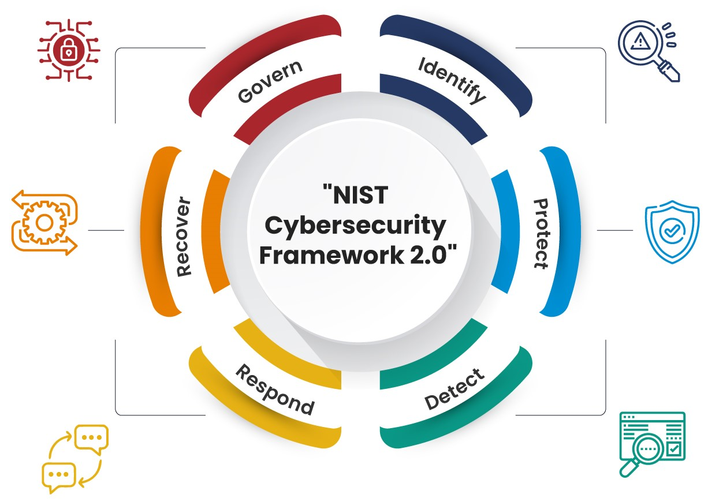
NIST Cybersecurity Framework 2.0

Slide 16
Govern
Identify
Protect
Detect
Respond
Recover
During the acquisition process, Marriott did not complete the proper audits of Starwood’s systems.
September 8, 2018, Marriott received an alert from an internal security tool regarding an attempt to access the Starwood guest reservation database in the United States.
The breach exposed weaknesses in Marriott's data protection measures, highlighting the need for improved encryption protocols and access controls to safeguard sensitive information.
Marriott's detection mechanisms failed to identify the breach promptly, allowing unauthorized access to persist undetected for several years.
Marriott responded to the breach by launching an investigation, notifying affected individuals, and cooperating with law enforcement agencies.
Marriott implemented remediation measures to enhance its cybersecurity posture, including strengthening network security, improving threat detection capabilities, and providing affected guests with identity monitoring services.

Slide 17
Timeline
Marriott faces scrutiny and legal challenges over its handling of the breach, including criticism regarding the timing and adequacy of its disclosure.
Starwood’s reservation database had a security vulnerability that allowed unrestricted access
Marriott announces the discovery of unauthorized access to its Starwood guest reservation database
Investigations into the breach reveal that unauthorized access had persisted undetected for several years
Nov 30, 2018
Feb 2019
2016
2014
Nov 19, 2018
Jan 2019
Following Months
Marriott acquired Starwood for $13.6 billion, creating the world’s largest hotel chain
Marriott publicly disclosed the breach, revealing that up to 500 million guest records were potentially compromised.
Marriott discloses that the breach also exposed millions of passport numbers, further exacerbating the impact of the incident

Slide 18
Common Vulnerabilities- Nuclei
CVE-2001-0537- HTTP server for Cisco IOS 11.3 to 12.2 allows attackers to bypass authentication and execute arbitrary commands, when local authorization is being used, by specifying a high access level in the URL.
CVSS Version 2.0 Base Score: 9.3 HIGH
CVE-2002-1131- Cross-site scripting vulnerabilities in SquirrelMail 1.2.7 and earlier allows remote attackers to execute script as other web users via (1) addressbook.php, (2) options.php, (3) search.php, or (4) help.php.
CVSS Version 2.0 Base Score: 7.5 HIGH
CVE-2005-3344- The default installation of Horde 3.0.4 contains an administrative account with a blank password, which allows remote attackers to gain access.
CVSS Version 2.0 Base Score: 10.0 HIGH

Slide 19
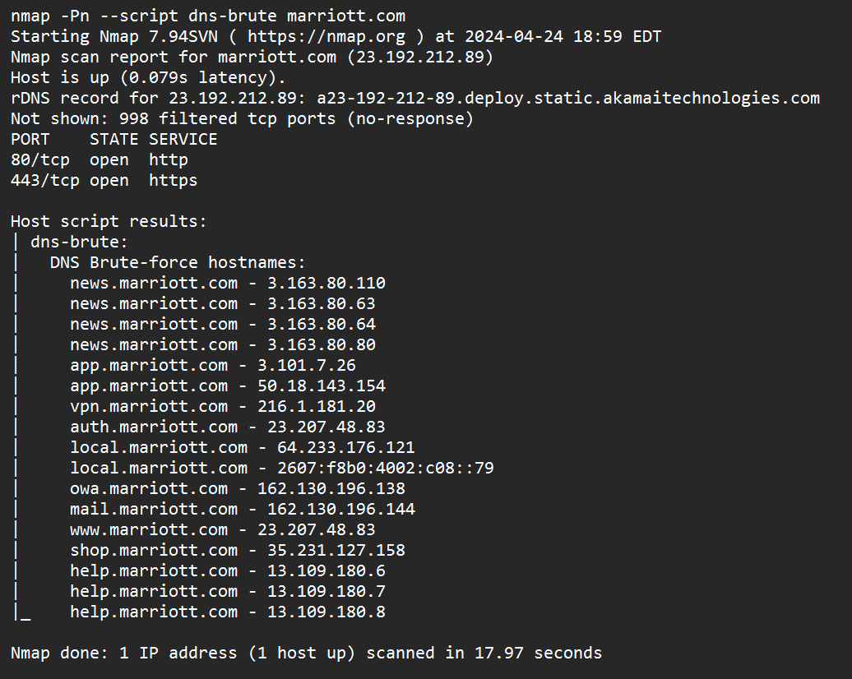
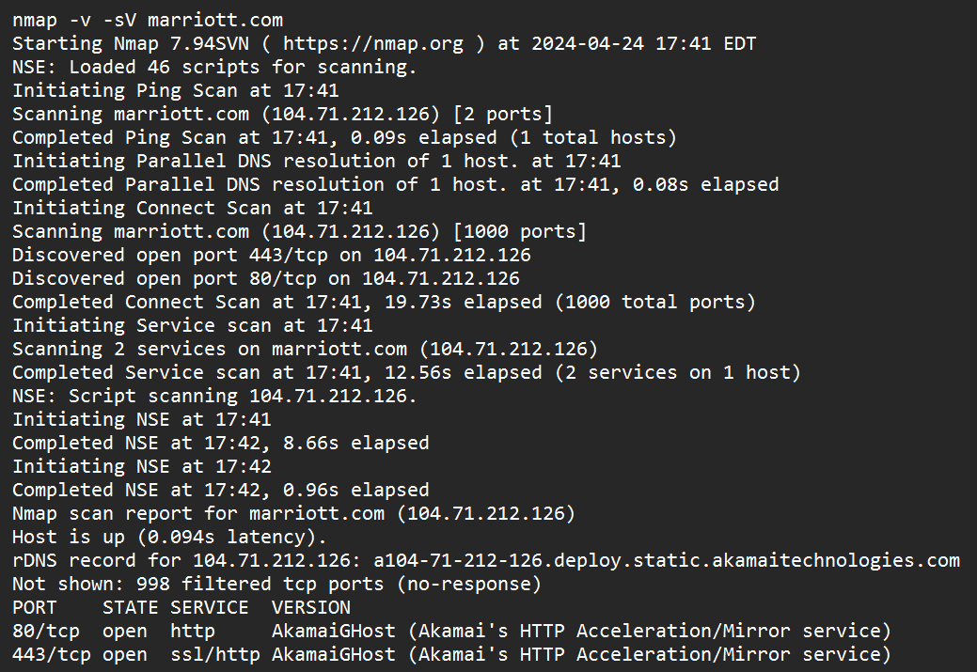
Zenmap Report

Slide 20
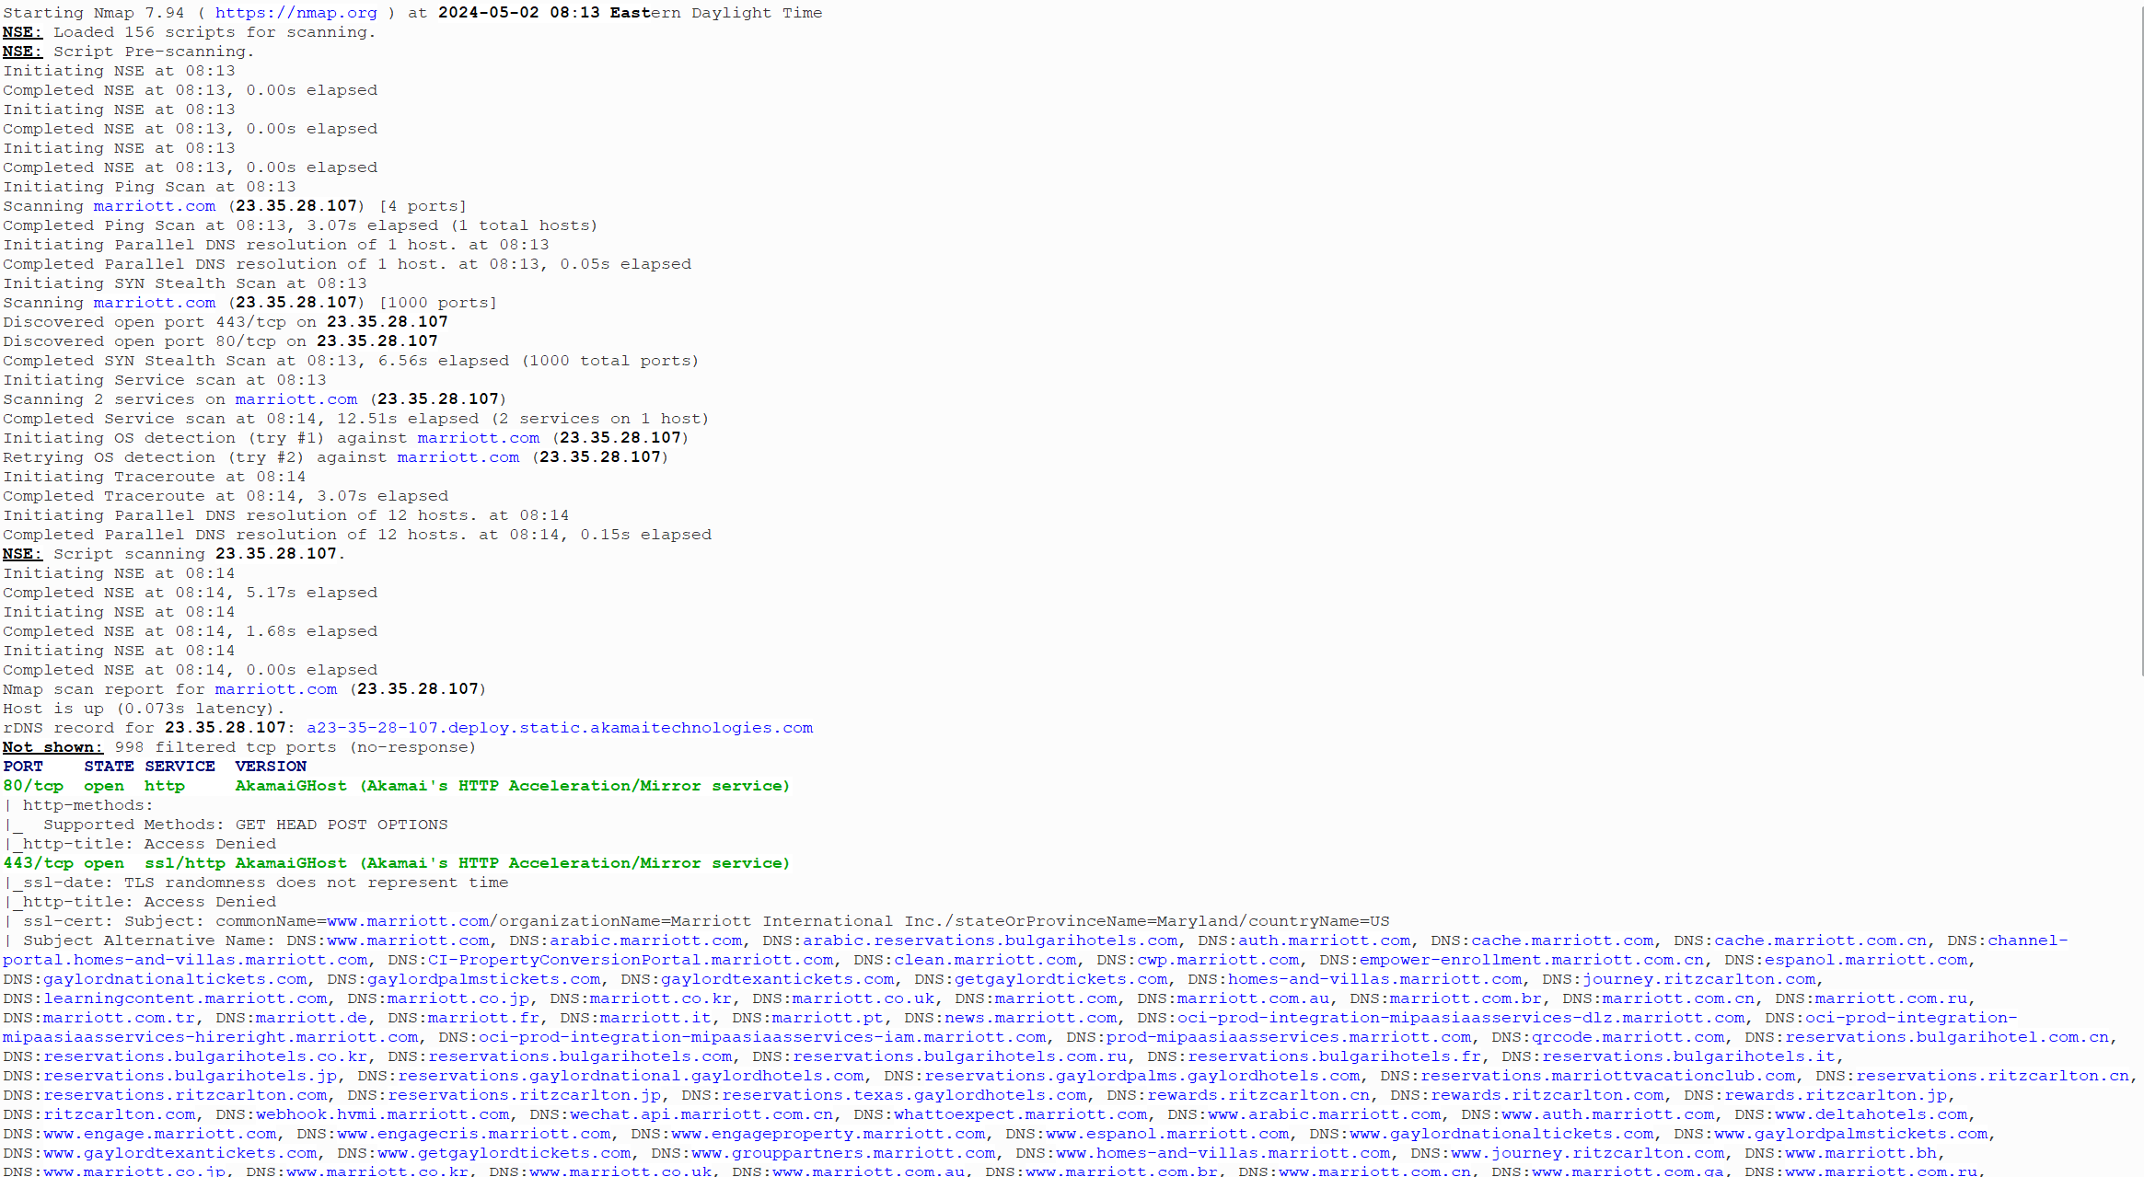

Slide 21
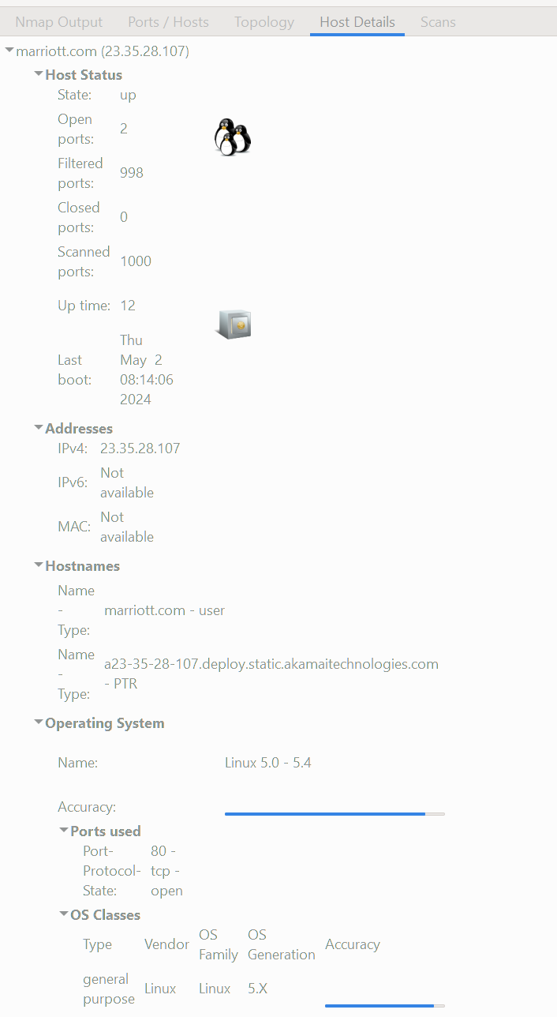

Slide 22
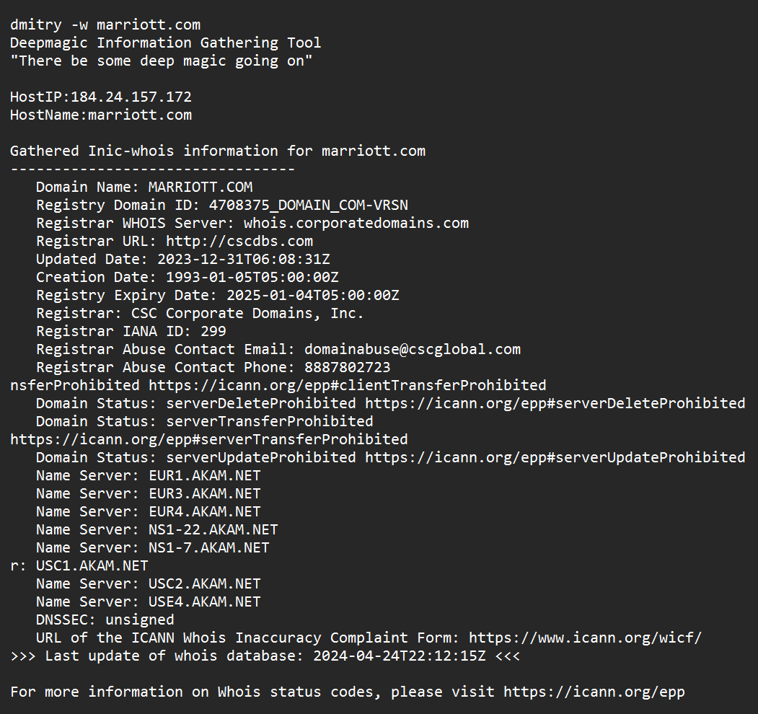
Dmitry –w marriott.com

Slide 23
AMASS Threat Landscape

Slide 24
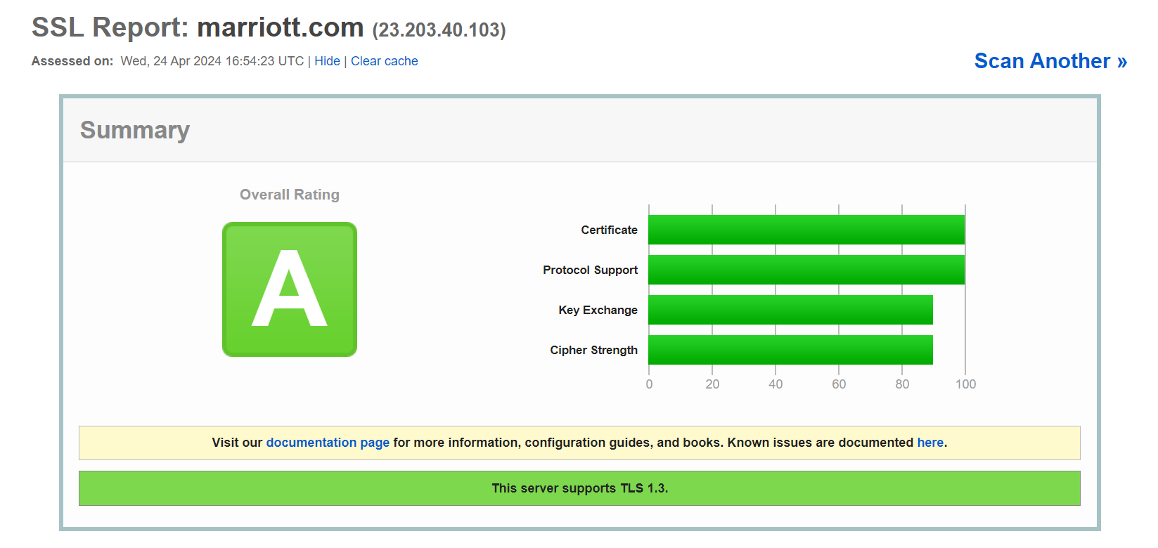
SSL Labs Report

Slide 25
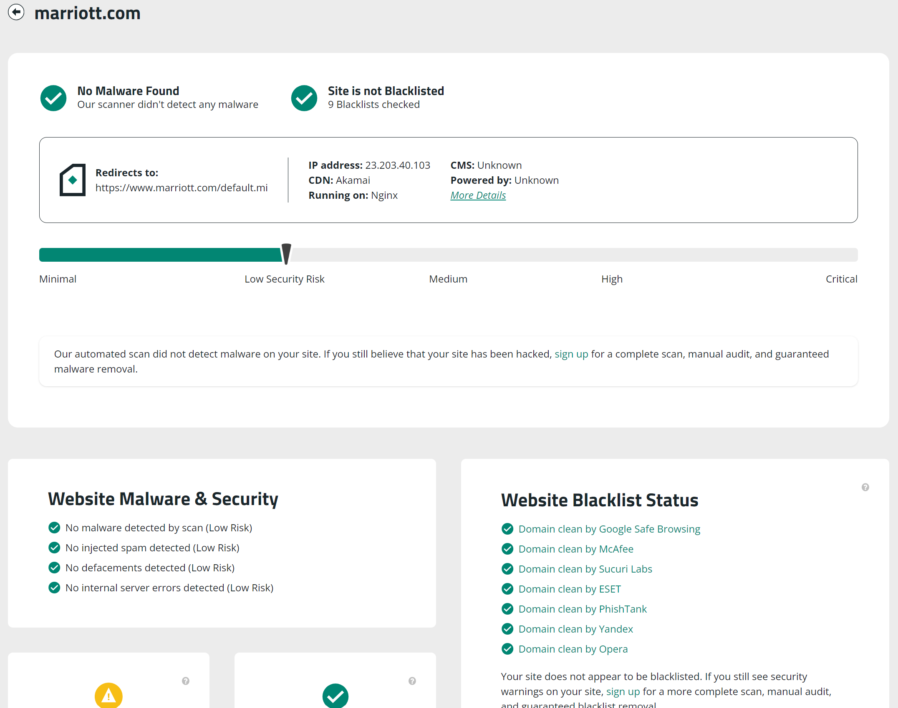
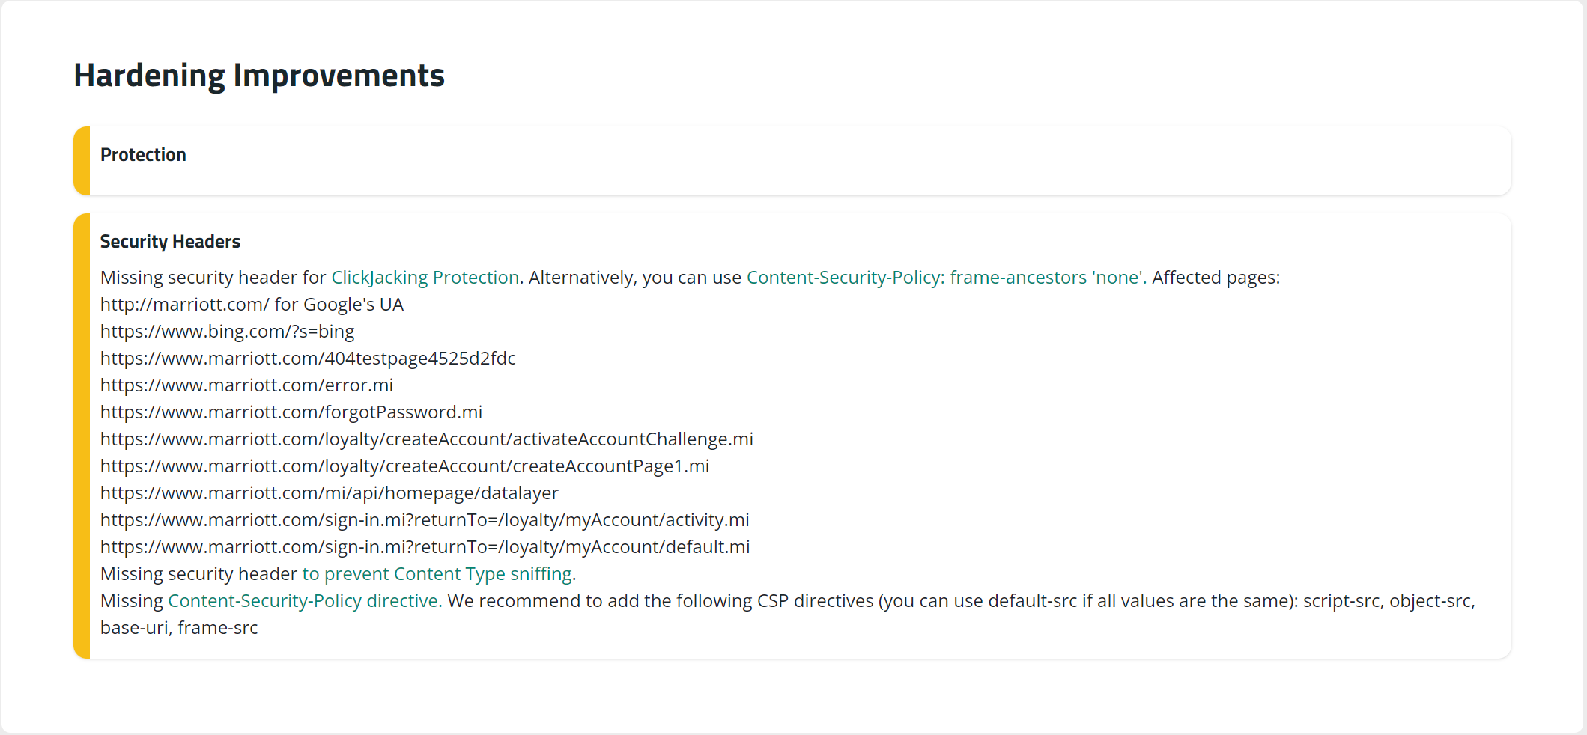
Sitecheck Sucuri

Slide 26
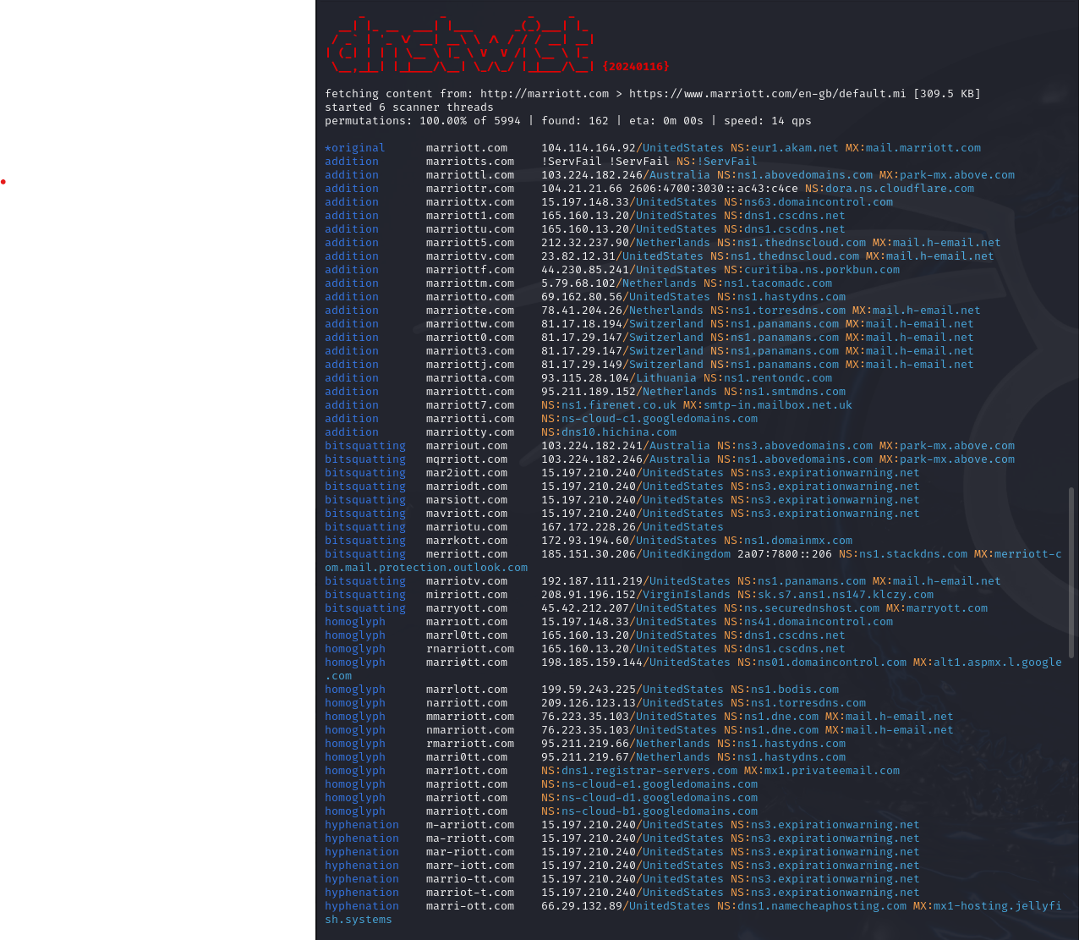
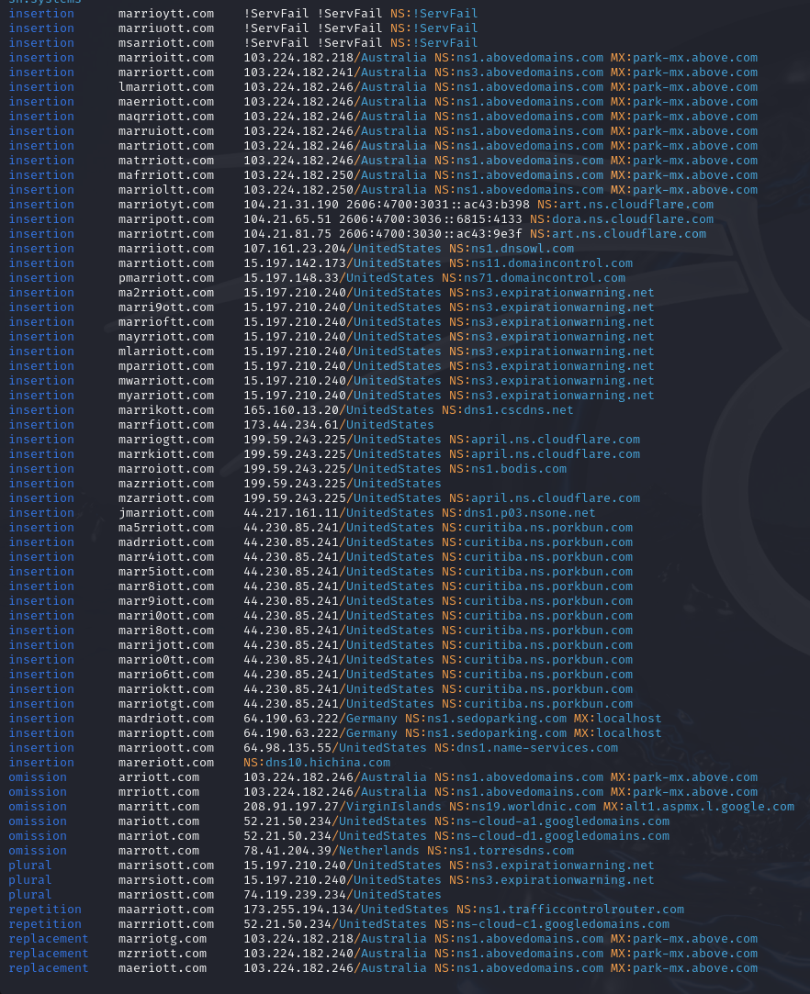
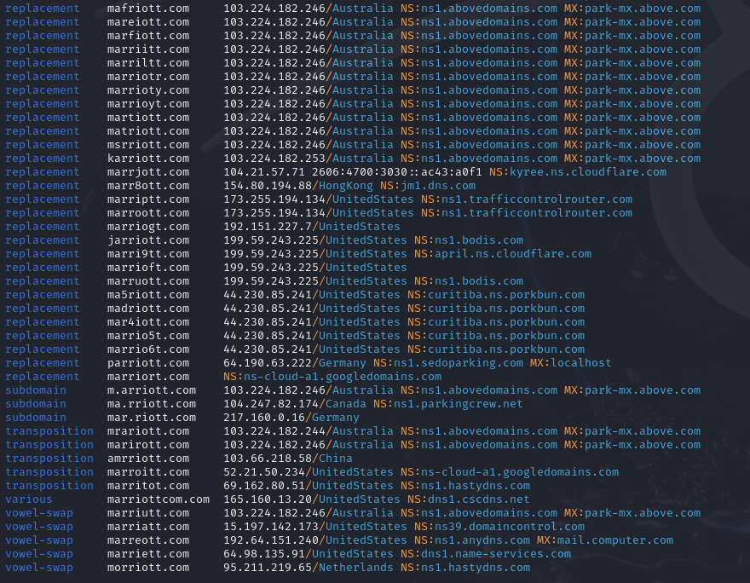
dnstwist -r -g -s -m marriott.com

Slide 27
Starwood’s History of Cyberattacks
(2014) Guest Reservation Database is infiltrated
Remote Access Trojan (RAT)
(2015) Starwood targeted in unrelated attack
Workplace devices infected with malware

Slide 28
Vulnerabilities in Starwood’s Networks
Outdated versions of Windows Server
Open TelNet & RDP ports

Slide 29
Conclusions
Marriott may have opted to not adequately address cybersecurity concerns because the company calculated that the cost of doing so would be more than the cost of dealing with a breach.
Final cost measured in billions of dollars
Breach likely damaged both national security and potentially the individual security of the millions of affected customers

