Slide 1
The Okta Breach of 2022
By Noah Shelton, Hunter Parris and Kayden Reich
Information assurance
CITC-1351-025
Professor George Meghabghab

Slide 3
What is
Okta is an IAM (Identity And Management) provider for large and small businesses. Their customers include Nordstrom, MGM Resorts, and even the D.o.J.
As an IAM, Okta provides easily used authentication and authorization services. Essentially, they’re a cloud-based SaaS (Security as a Service) business.
This makes them particularly appealing to attackers due to them holding customer data which can help threat actors breach client servers.

Slide 4
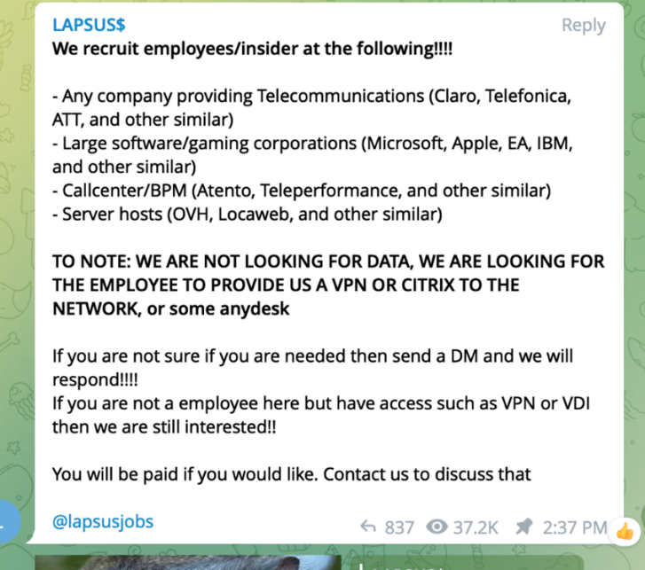
‘LAPSUS$’
An international group of black-hat hackers, LAPSUS$ was the group behind the 2022 Okta Breach.
According to a report by Microsoft, where LAPSUS& were assigned the title ‘DEV-0537’, LAPSUS& is primarily known for social engineering attacks, preferring to pay or extort employees out of credentials or computer access.

Slide 5
What is
Sitel, a company that was acquired by Sykes (A customer support business). Was a sub-process of Okta’s SaaS business. They were contracted to handle customer support for Okta.
Due to Sitel being a separate company only contracted by Okta, they were relatively unsupervised and therefore not held up to Okta’s security standards, leading to the eventual breach in January 2022.
Upon the breach's discovery, Sitel hired a forensic firm called Mandiant, which conducted an investigation between Jan 21, 2022, to Feb 18, 2022.

Slide 6
The Breach
Due to an RDP connection to a Sitel Support Engineer’s Computer, LAPSUS$ could establish a foothold, escalate privileges, and eventually reach company data.
Due to the breach being undisclosed, it’s up for grabs how LAPSUS$ acquired access to the Support Engineer’s PC beyond RDP. However, due to their history, it’s assumed to be by extortion or social engineering.
LAPSUS& had access for five days according to the report. Though they only had access to limited customer data (Usernames, names. No credentials)

Slide 7
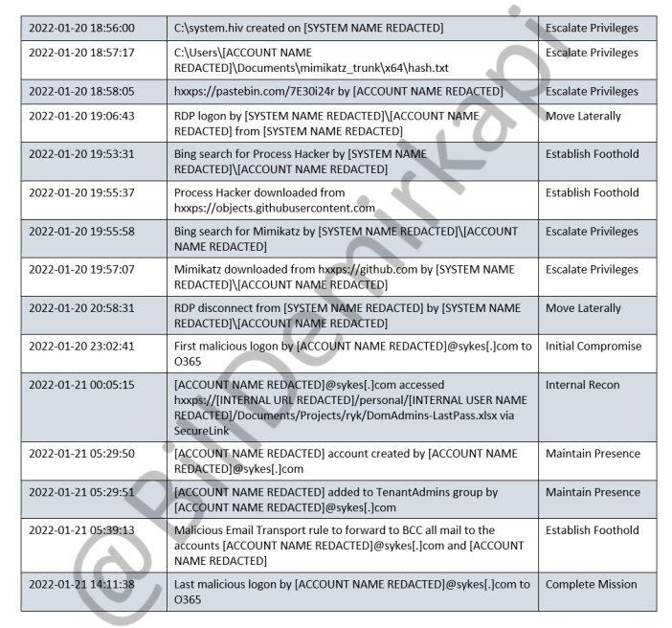
Mandiant’s timeline.

Slide 8
Okta’s Timeline

Slide 9
CVE-2021-34484
Discovered by Abdelhamid Naceri and patched by Microsoft on August 10th 2021. The CVE-2021-34484 vulnerability abused the User Profile Service (UPS) by utilizing attacker-made symbolic links to temporarily user profile files made by the UPS when said user profile is locked or damaged. These symbolic links allowed the attacker to execute their malicious DLLs.
Microsoft underestimated the vulnerability, only giving it a patch that was essentially a band-aid solution, allowing LAPSUS$ to access a bypass that allowed them to escalate their privileges on the hijacked PC.

Slide 10
Tools of the attack.
Process Hacker
Mimikatz
An advanced form of task manager, Process Hacker allows someone to view the details behind processes on a PC, including hidden processes.
This was importantly used by LAPSUS$, where they were capable of killing the FireEye endpoint service, which further escalated access to the PC.
A popular credential dumping software that can gather credentials through a variety of vulnerability exploitation
This was used by LAPSUS$, so they could capture credentials on the breached PC for further access escalation.

Slide 11
In Conclusion.....

Slide 12
The Aftermath
Lessons Learnt
Despite LAPSUS$ successfully breaching Sitel’s customer support system, they only had access to basic customer information such as username, first and last names, etc. When it came to credentials, all they could do was force password resets, but they couldn’t actively see credentials as they were reset. While this still leads to the possibility of advanced social engineering attacks, their access was still heavily limited before being booted off by Sitel.
Due to the breach, Okta immediately cut all ties with Sitel and Sykes, the company which owns Sitel. Now Okta manages all third-party devices that perform services for Okta. They now specifically enforce a zero-trust policy in all third party companies they contract.
Obviously, one must question why Okta let a third-party company like Sitel handle customer data with almost no oversight. Evidently, Okta learned from this and now enforces a zero-trust policy with all its third-party associates.
Following the leak of customer information from Sitel, Okta now heavily restricts what kind of information a customer support engineer has access to.

Slide 13
Okta Site Analysis & NMAP
Nmap scan used: nmap –Pn –A 44.210.3121/24

Slide 14
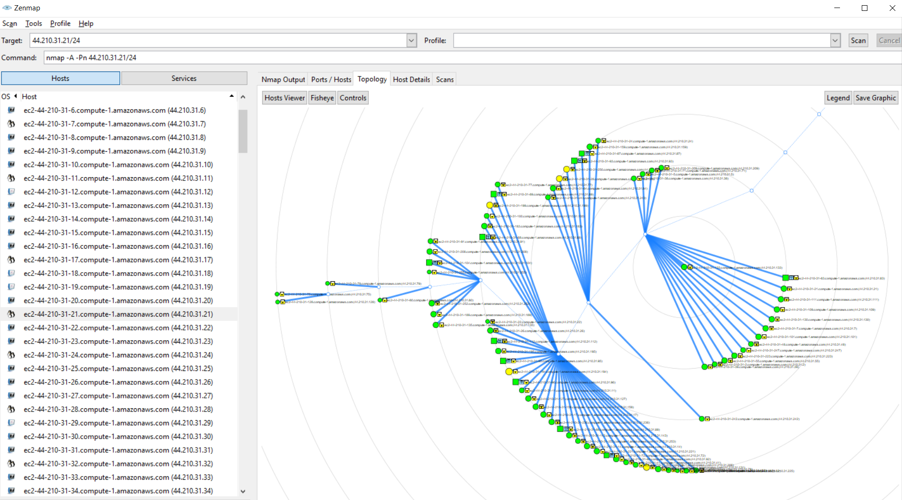
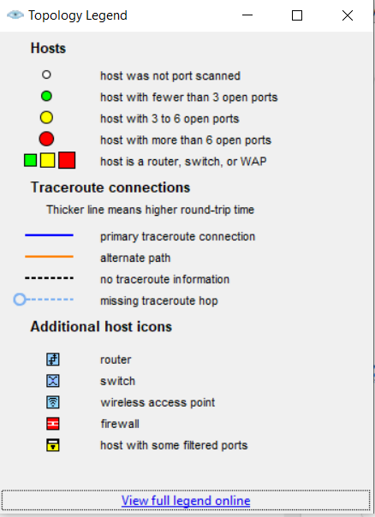

Slide 15
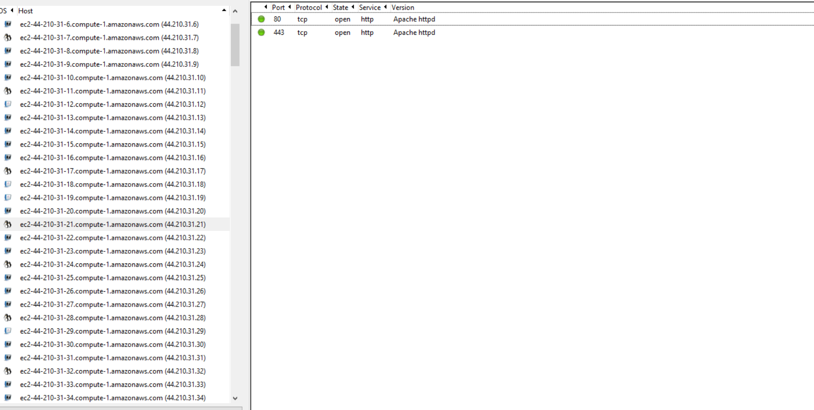

Slide 16
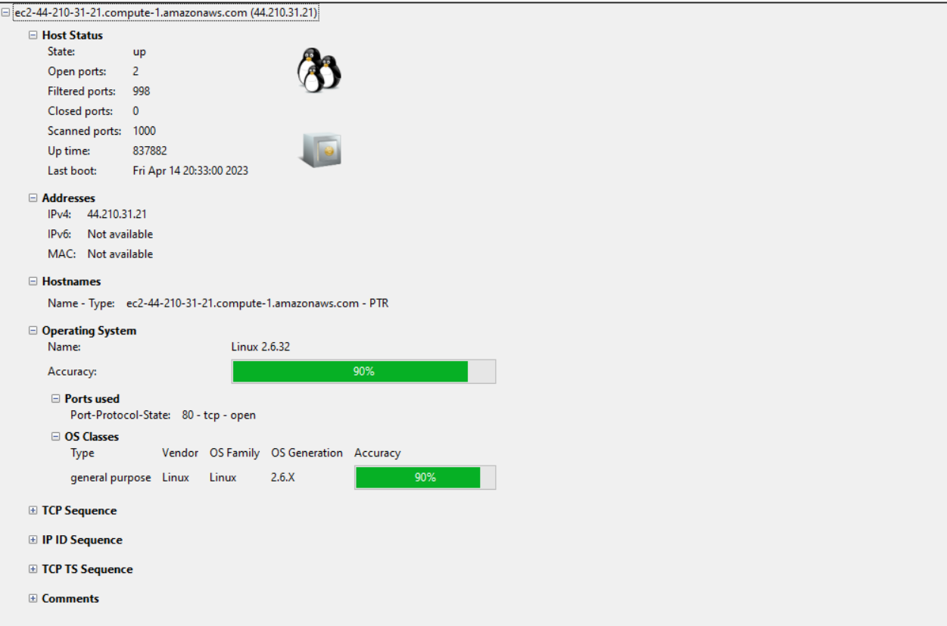

Slide 17
Dnstwist Okta.com A small URL, yet so many ways to twist. This is only some out of 550 possibilities it gave

Slide 18
SSL Report
SSL Labs

Slide 19
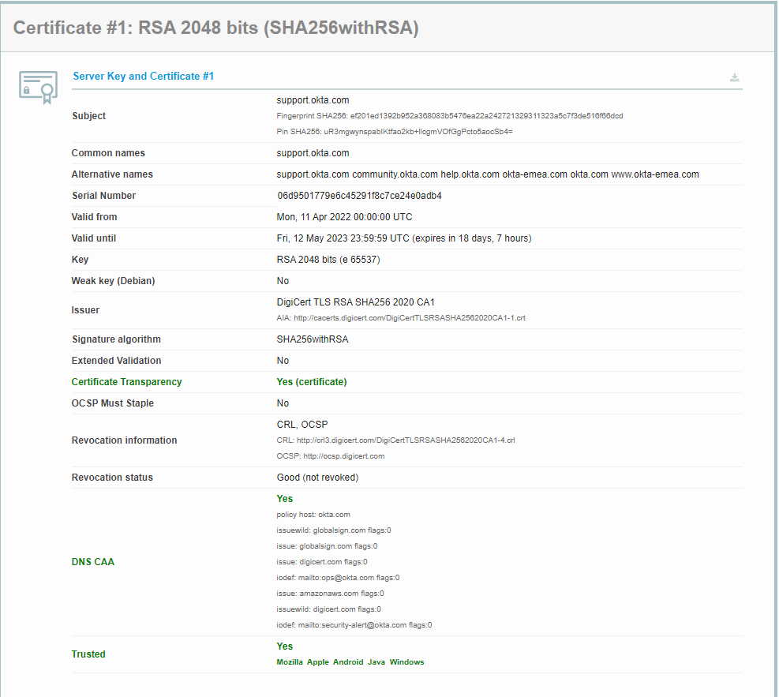

Slide 20
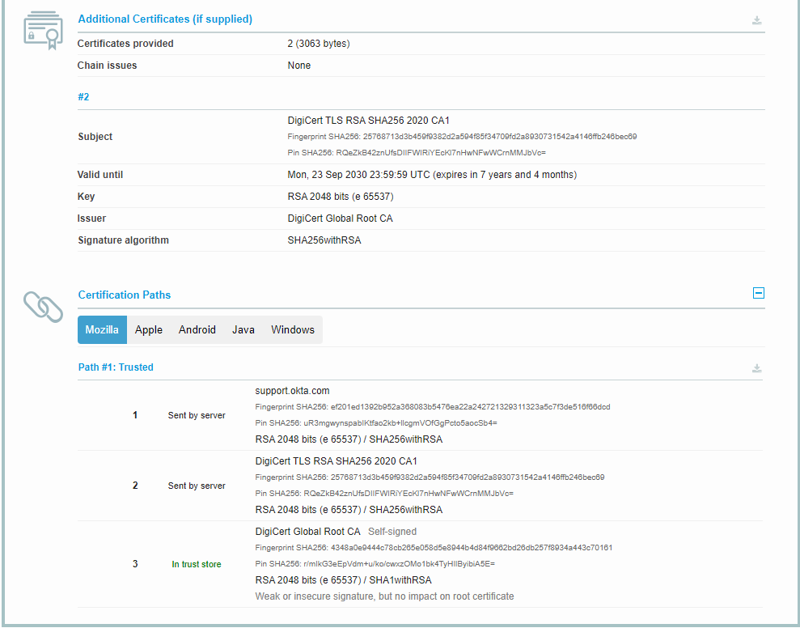

Slide 21
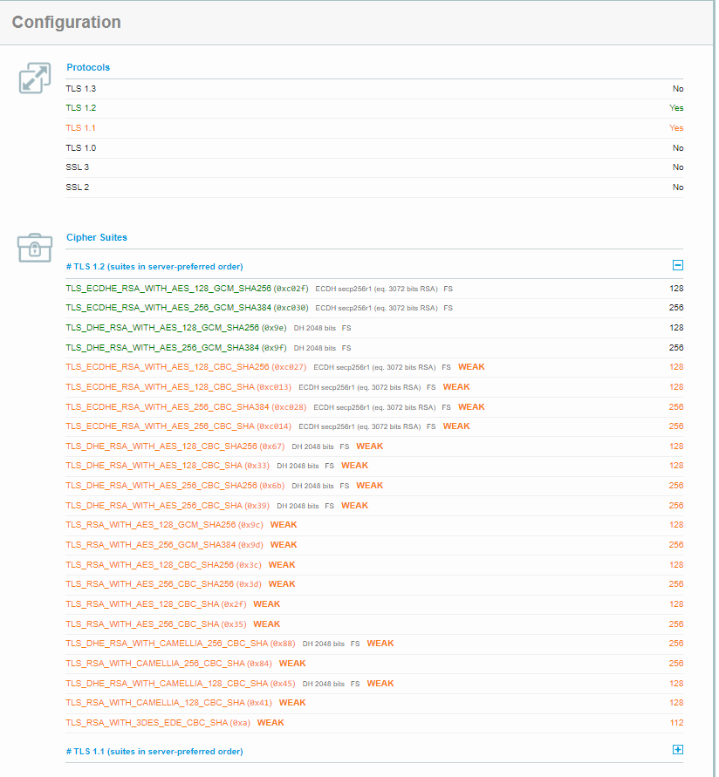

Slide 22
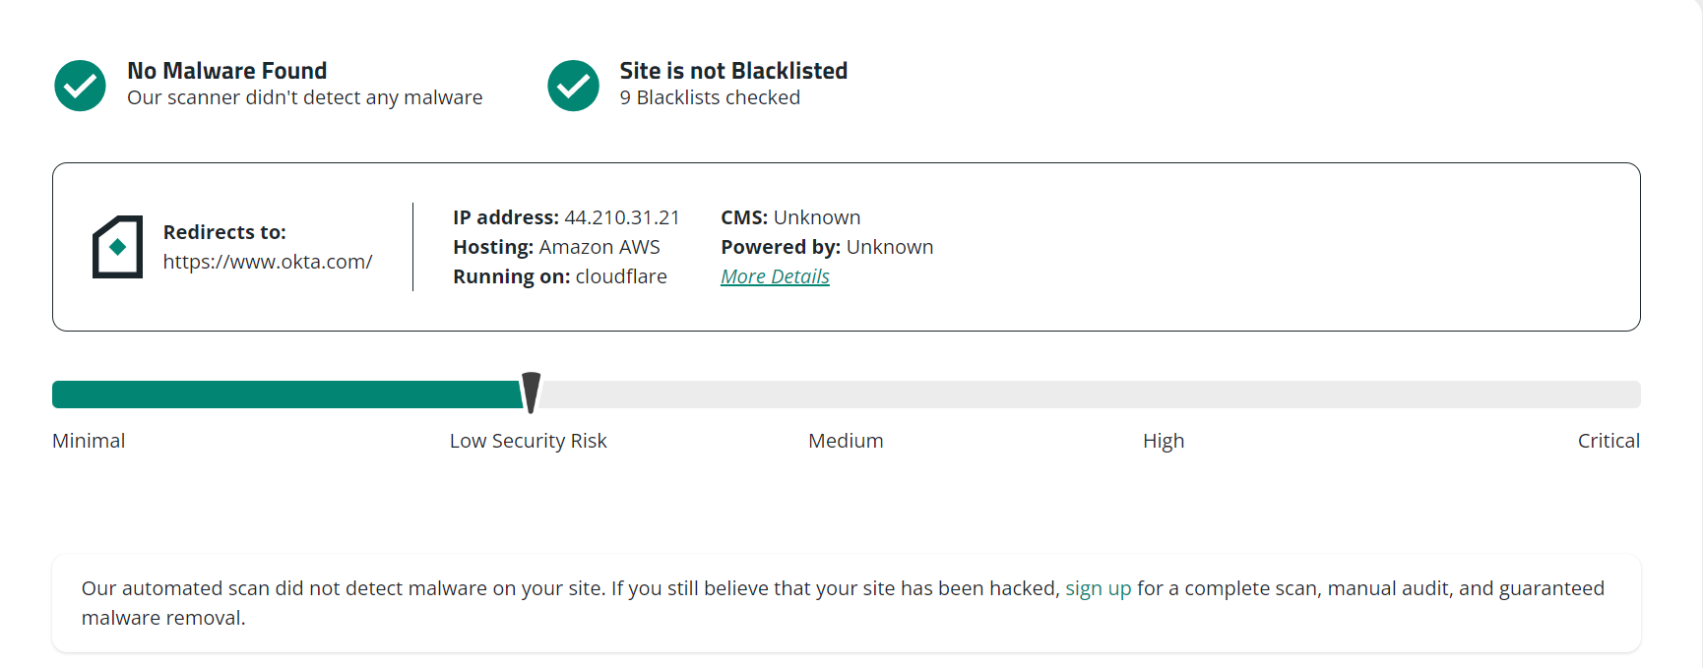
Sitecheck

Slide 23
DNS Dumpster

Slide 24
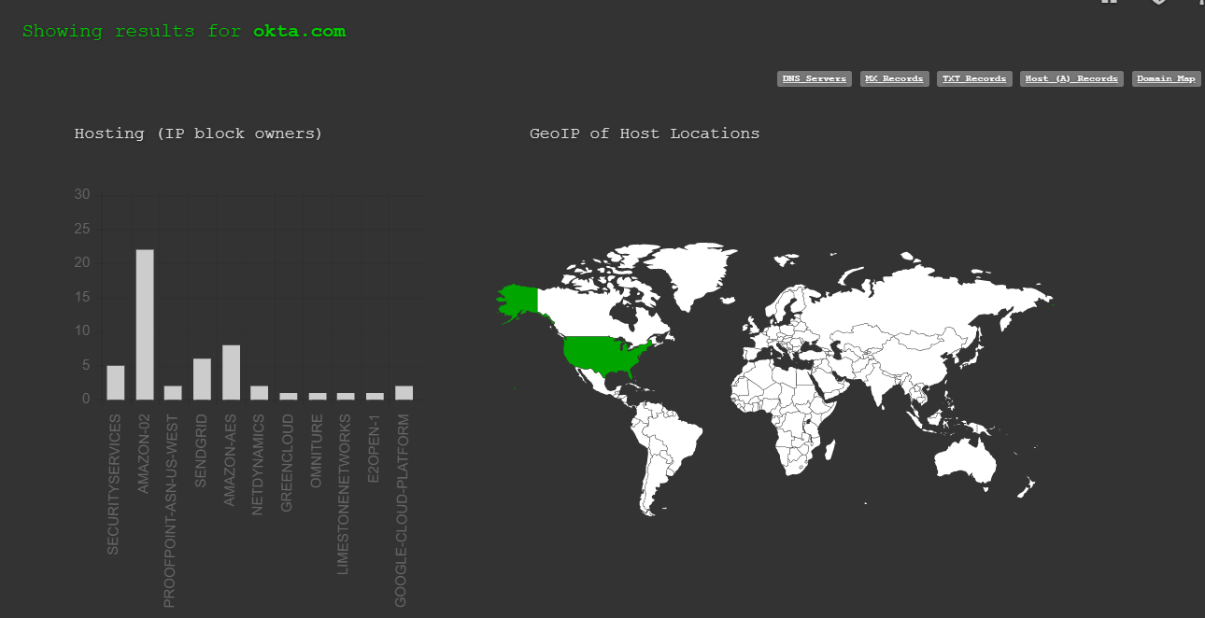

Slide 25
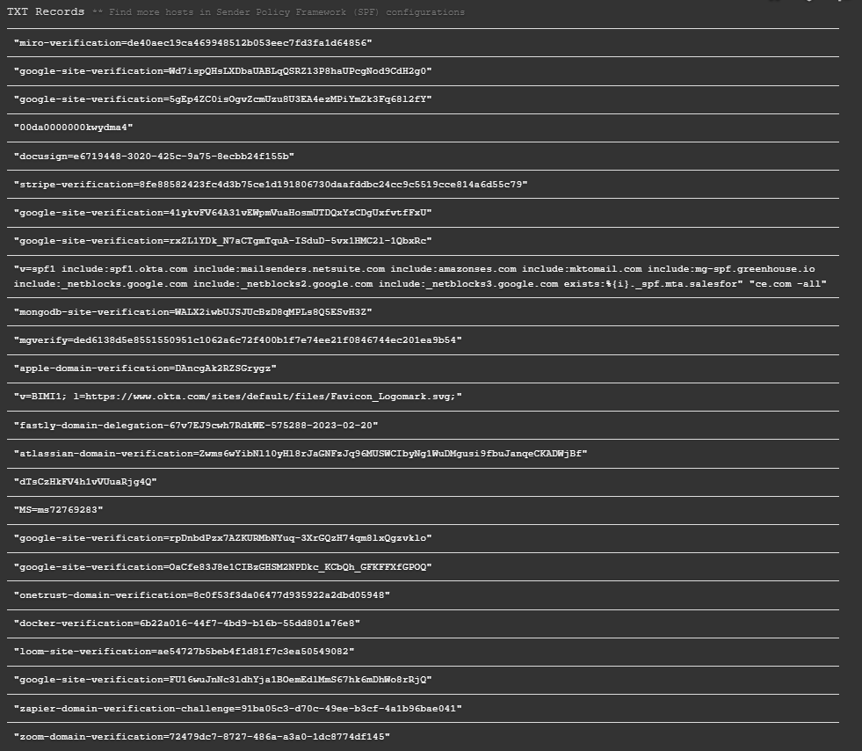

Slide 26
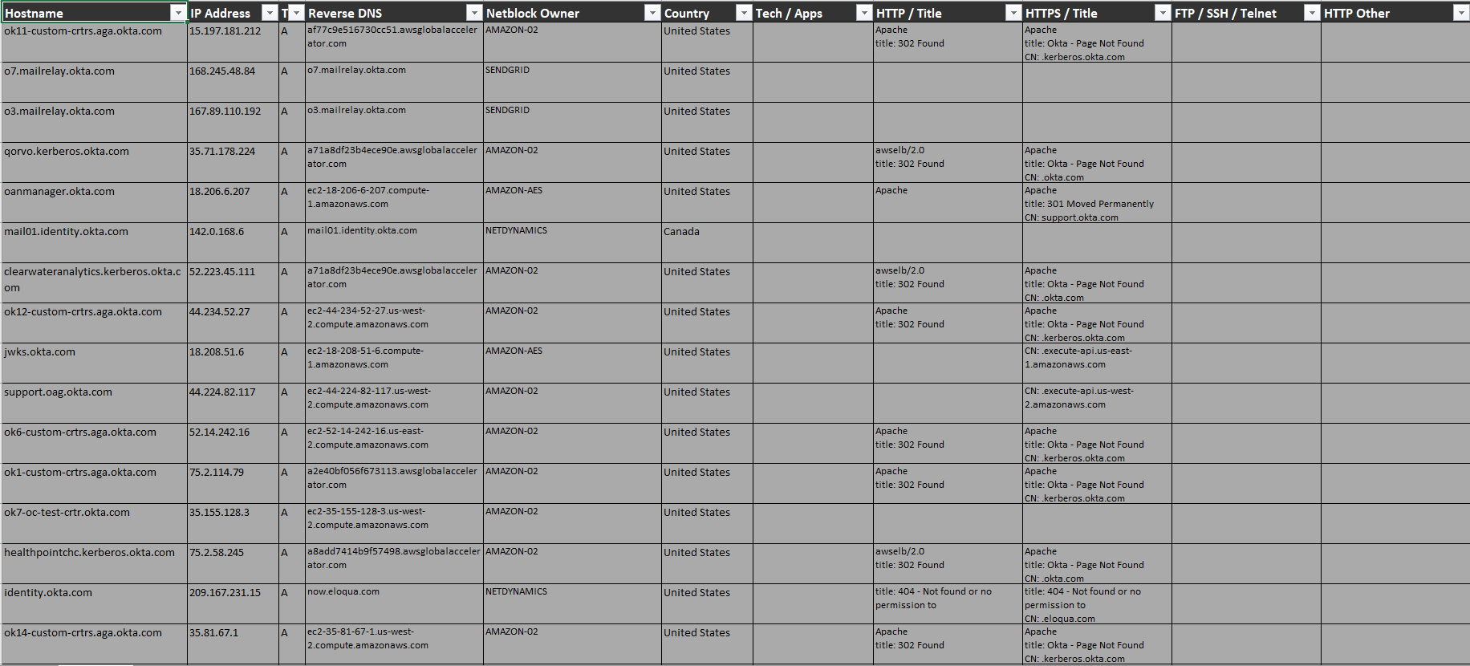

Slide 27
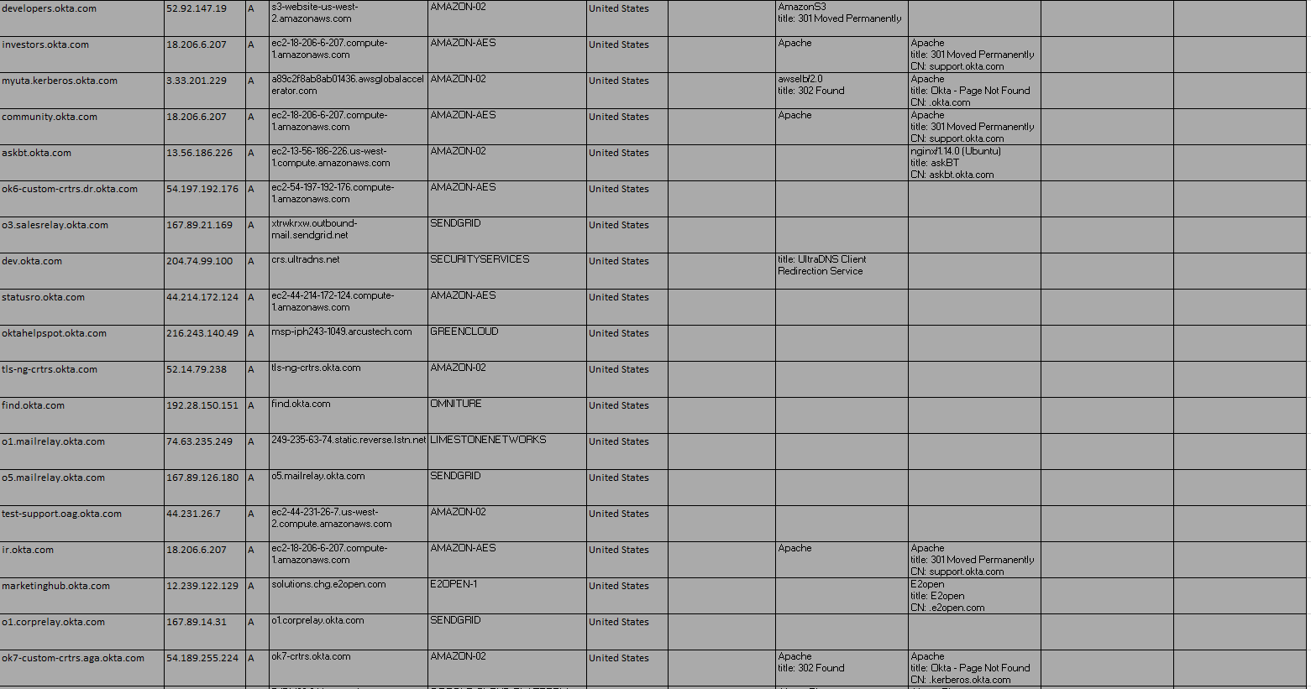

Slide 28
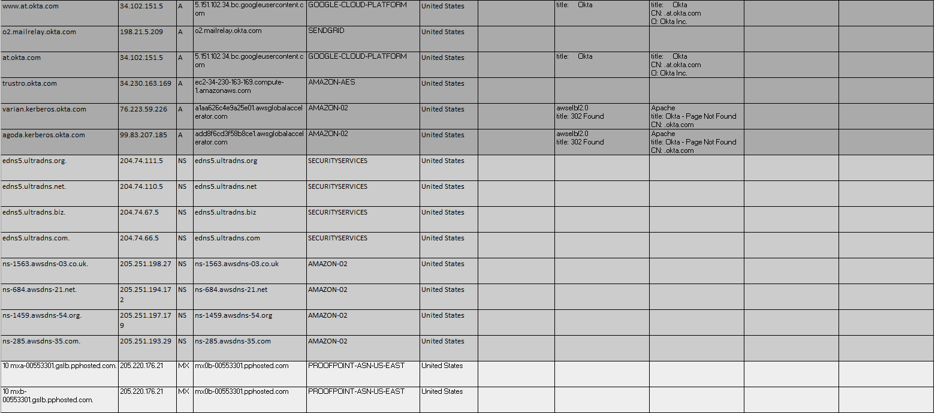

Slide 29
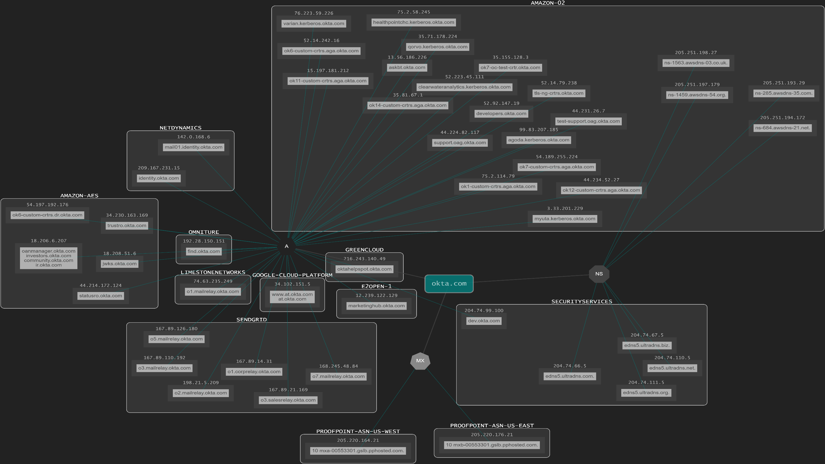
DNS Dumpster

Slide 30
Sources
https://thesecmaster.com/how-to-fix-cve-2021-34484-a-new-zero-day-local-privilege-escalation-vulnerability-in-microsoft-windows/
https://www.forbes.com/sites/thomasbrewster/2022/03/23/okta-hack-exposes-a-huge-hole-in-tech-giant-security/?sh=4a2abc4a35a5
https://cve.mitre.org/cgi-bin/cvename.cgi?name=CVE-2021-34484
https://www.ssllabs.com/ssltest/analyze.html?d=okta.com
https://support.okta.com/help/s/article/Frequently-Asked-Questions-Regarding-January-2022-Compromise?language=en_US&_gl=1*9sy84t*_ga*MTgzMjQ0OTA4OS4xNjQ3OTI0OTUw*_ga_QKMSDV5369*MTY0ODQ5MjQ2NC44LjAuMTY0ODQ5MjQ2NS41OQ..&_ga=2.99797534.1289034198.1648398592-1832449089.1647924950
https://www.okta.com/blog/2022/03/updated-okta-statement-on-lapsus/
https://iics.medium.com/cve-2021-34484-zero-day-vulnerability-affects-billions-of-windows-users-no-patch-available-492fb7df16fa
https://www.varonis.com/blog/what-is-mimikatz
https://www.malwarebytes.com/blog/news/2018/11/advanced-tools-process-hacker
https://twitter.com/BillDemirkapi/status/1508527487655067660
https://investor.sykes.com/company/investors/corporate-profile/default.aspx#
https://www.okta.com/blog/2022/03/oktas-investigation-of-the-january-2022-compromise/
https://www.okta.com/blog/2022/04/okta-concludes-its-investigation-into-the-january-2022-compromise/
https://www.microsoft.com/en-us/security/blog/2022/03/22/dev-0537-criminal-actor-targeting-organizations-for-data-exfiltration-and-destruction/

