Slide 1
TJX 2007 BREACH
Clint Hyde and Matt Hicks
Information Assurance Breach Presentation

Slide 2
TJX Companies
Companies in the US:
T.J. Maxx
Marshalls
HomeGoods
HomeSense
Sierra
TJX Companies describes itself as “the leading off-price apparel and home fashions retailer in the U.S. and worldwide.”
They started in 1977 with two stores in Massachusetts and have since expanded to 4835 stores across 9 countries

Slide 3
Incident - “Computer Intrusion”
On January 17, 2007, TJX disclosed to the public it was the victim of a data breach and referred to it as the “Computer Intrusion.” TJX determined it had threat actors inside its IT systems for nearly 18 months: from July 2005 through December 2006.
“We suffered an unauthorized intrusion into portions of our computer systems that process and store information related to customer transactions that we believe resulted in the theft of customer data. We do not know who took this action and whether there were one or more intruders involved (we refer to the intruder or intruders collectively as the “Intruder”), or whether there was one continuing intrusion or multiple, separate intrusions (we refer to the intrusion or intrusions collectively as the “Computer Intrusion”). We are engaged in an ongoing investigation of the Computer Intrusion, and the information provided in this Form 10-K is based on the information we have learned in our investigation to the date of this Form 10-K. We do not know what, if any, additional information we will learn in our investigation, but that information could materially add to or change the information provided in this Form 10-K.”

Slide 4
FTC Complaint

Slide 5
Threat Agents
A group of 11 people, led by Albert Gonzalez and known as the Gonzalez gang were deemed responsible as part of their “Operation Get Rich or Die Tryin” that began in 2005.
Albert Gonzalez was a confidential informant for the Secret Service during the time he and his gang were secretly hacking TJX and other companies.

Slide 6
Threat Agent’s Tactics
War-driving to find vulnerable networks led them to two Marshalls locations in Miami, FL.
They intercepted transmissions between bar code scan guns and data receivers that were connected to the corporate network
Using these intercepted transmissions, they were able to crack the WiFi, and gain access by creating accounts or stealing usernames/passwords to ultimately get to the corporate servers housing credit/debit card transactions.
Some sources also indicated that they tampered with publicly available in-store kiosks on the network and installed software from a usb, giving them remote access to the kiosk and the corporate servers.
Set up VPN to allow them to move in and out without detection(the same one allegedly designed by the Secret Service and used during Gonzalez’s time as an informant)
After realizing many of the card numbers they were obtaining were expired, the hackers developed a program “blabla” to capture more recent transactions that would automatically encrypt, compress, and forward the data to Gonzalez.

Slide 7
How did they get caught?
Maksym Yastremskiy, Gonzalez’s fence, had saved and catalogued all of his customer lists and instant messages for years. In logs obtained by law enforcement, they found a chat partner who appeared to be Yastremskiy’s biggest provider of stolen card data. But all they had for the person was an I.M. registration number — no personal information.
Secret Service technicians finally got the I.M. registration information for whoever was providing Yastremskiy with bank-card data. There was no address or name, but there was an e-mail address: soupnazi@efnet.ru
Gonzalez’s favorite alias was soupnazi, so this was a dead giveaway to the Secret Service of his involvement.

Slide 8
Computer Intrusion Timeline
July 2005-First access by hackers.
Dec 19, 2006 TJX begins working with IBM and General Dynamics to monitor and evaluate the intrusion
Dec 18, 2006-TJX learned of suspicious software on their computer systems.
January 17, 2007 TJX releases statement to public stating they have suffered an unauthorized intrusion on computer systems related to customer transactions
Dec 22-27 2006 TJX notified U.S. law enforcement, contracted banks, and various payment processing companies of the intrusion.
July 2007-First arrest that ultimately led to dissolution of the Gonzalez Gang.
May 7, 2008-Albert Gonzalez arrested

Slide 10
TJX Vulnerabilities
Threat Agents:
Albert Gonzales
And Company
TJX was not in compliance with various PCI standards
Wireless network inadequately secured using WEP instead of WPA
No or minimal monitoring/security of physical assets in stores
No regular security or network auditing in place
TJX Servers
Victim:
TJX

Slide 11
Reason TJX Did Not Meet Security Standards
An email from the CIO of TJX that went public indicated that TJX was more concerned with saving money and skipping security/auditing requirements.
The CIO suggested delaying conversion of in-store wireless encryption standards from the easily cracked Wired Equivalent Privacy (WEP) to Wi-Fi Protected Access (WPA). He clearly understood that WEP was less than ideal, but at the time PCI did not explicitly mandate WPA. He believed TJX should take advantage of the leniency to save cash, in spite of the security risks.

Slide 12
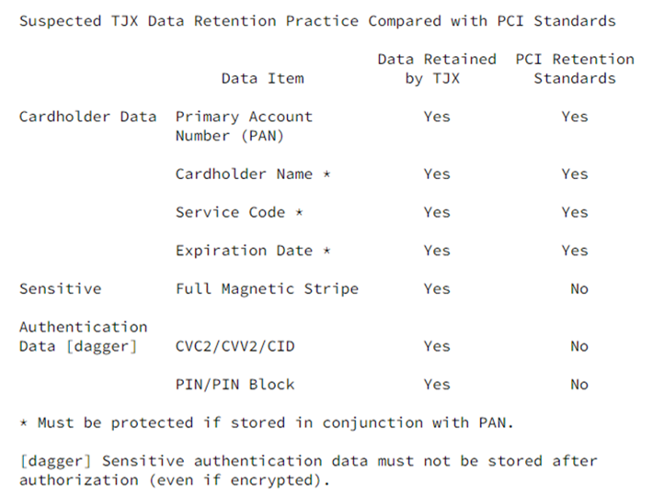
PCI Noncompliance
An audit of TJX’s network in 2004, showed that they were non-compliant with 9 of 12 requirements established by PCI for secure card transactions such as:
Misconfigured wireless network
Improper anti-virus protection
Weak intrusion detection
Lax password policies
Improper patch procedures and log maintenance

Slide 13
Wired Equivalent Privacy (WEP)
TJX used WEP encryption to secure its wireless networks at the time of the initial access and states it was in the process of converting to WPA.
WEP was hackable in under a minute (allegedly 3 seconds) as of 2003 and TJX did not begin their conversion to WPA until 2005

Slide 14
Physical Security
Pros
TJX had physical security measures such as security personnel, photo ID, swipe cards, surveillance cameras and locks in place at the time of the breach.
Cons
Hackers were able to access in-store kiosks and load software via usb. The kiosks were intended to be used by non-employees applying for jobs at the company.
The fact that the attackers were able to access and tamper with the kiosks, despite the fact of having implemented certain physical security applications, indicates the company did not take proper steps to physically secure and monitor IT assets at its store locations.

Slide 15
Firewalls
The FTC indicated that there were no measures in place to limit access among computers and the internet and that steps should have been taken to isolate the card authorization computers using a firewall.
There were no other mentions of firewalls and whether they did not have them in place or if they were misconfigured.

Slide 16
Auditing/Logging
FTC states TJX “failed to employ sufficient measures to detect and prevent unauthorized access to computer networks or to conduct security investigations, such as by patching or updating anti-virus software or following up on security warnings and intrusion alerts.”
If adequate monitoring had been in place for TJX systems, they should have been aware of the intrusion well before December 2006.
TJX did not have certain information on its systems that were needed to determine exactly what had been stolen in some instances due to “deletion in the ordinary course of business”
TJX also stated the technology used by the intruder made it impossible to determine the contents of the files they believe were stolen

Slide 17
Results of the Breach
Criminals stole data on an estimated 45-94 million credit/debit cards
Personal data provided in connection with the return of merchandise without receipts by about 451,000 individuals in 2003 was also stolen.
There were 19 class actions filed against TJX within the first 3 months of 2007
The total cost of the data breach exceeded 250 million
TJX ordered to implement and maintain a security program designed to protect PI collected from customers and obtain assessments from a third party every two years for twenty years, ending in 2028.
Albert Gonzalez was sentenced to 20 years in prison for his part in the breach of TJX and other companies.

Slide 18
Zenmap
RAN ZENMAP USING CLASS C IP 192.237.233.169/24
FOUND 53 HOSTS UP ON THE NETWORK
RAN ZENMAP USING CLASS B IP 168.233.20.88/24
FOUND 47 HOSTS UP ON THE NETWORK
RAN ZENMAP USING CLASS A IP 72.32.233.232/24
FOUND 25 HOSTS UP ON THE NETWORK

Slide 19
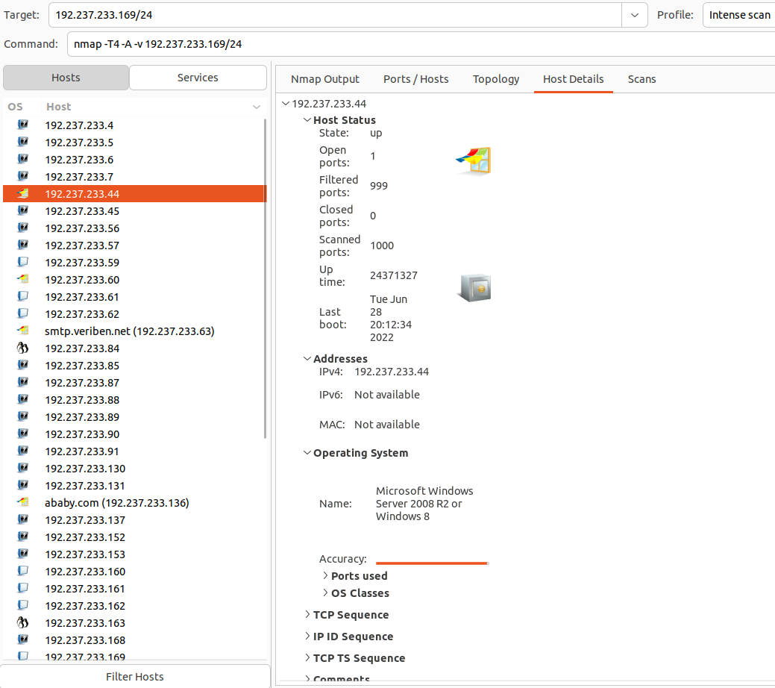
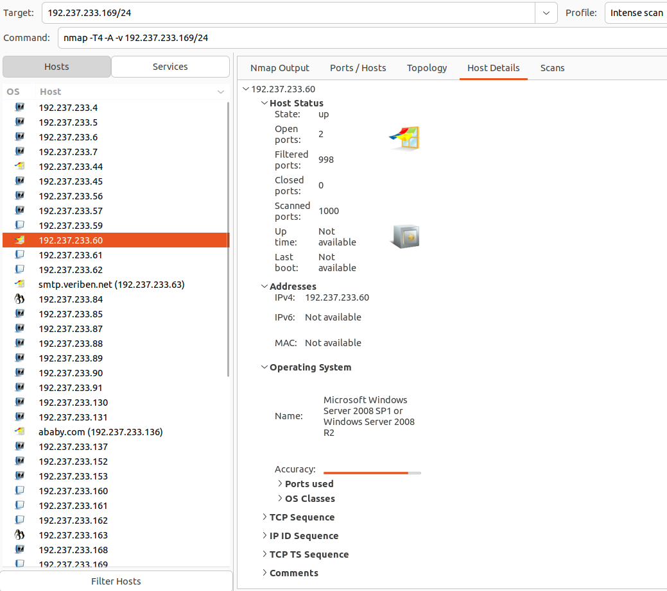
Zenmap Server Pictures - Class C
192.237.233.169

Slide 20
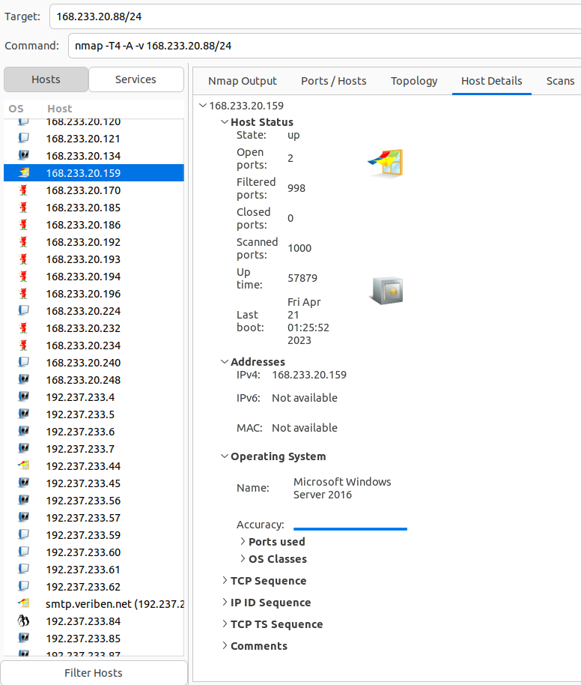
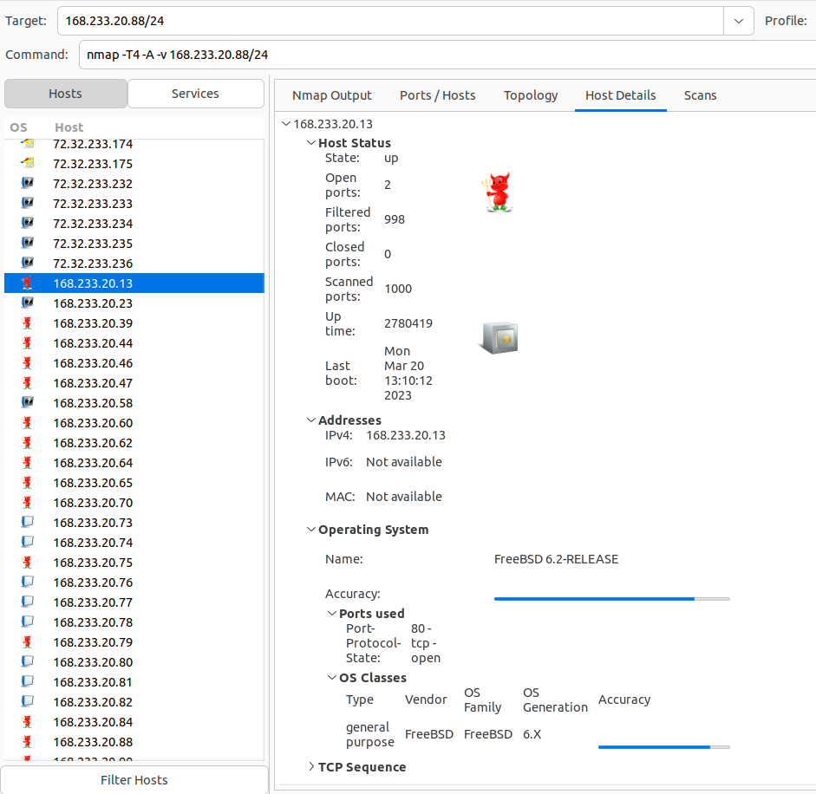
Zenmap Server Pictures - Class B
168.233.20.88

Slide 21
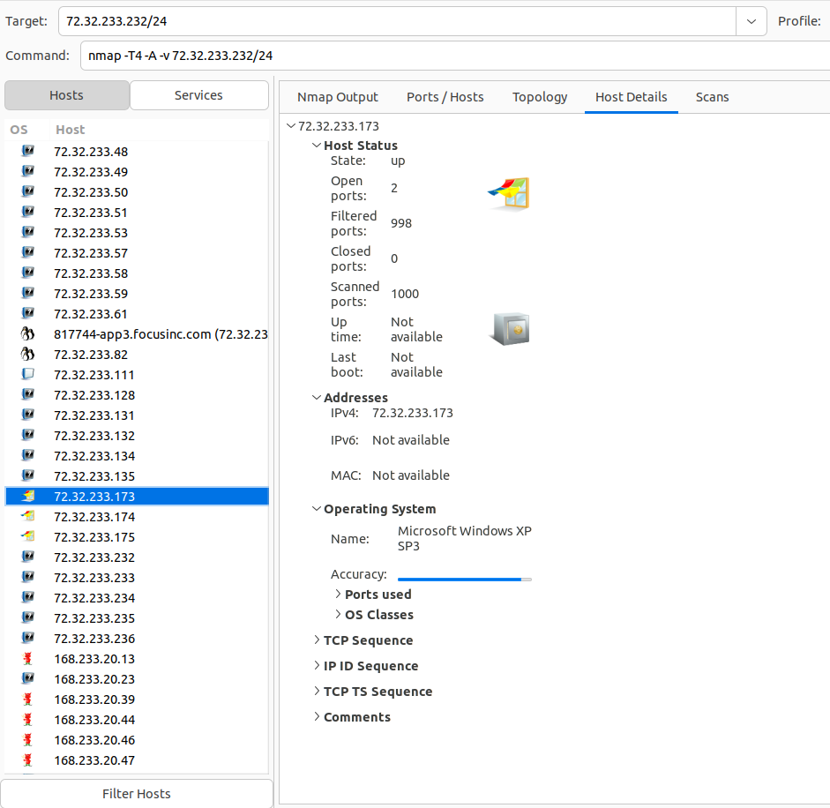
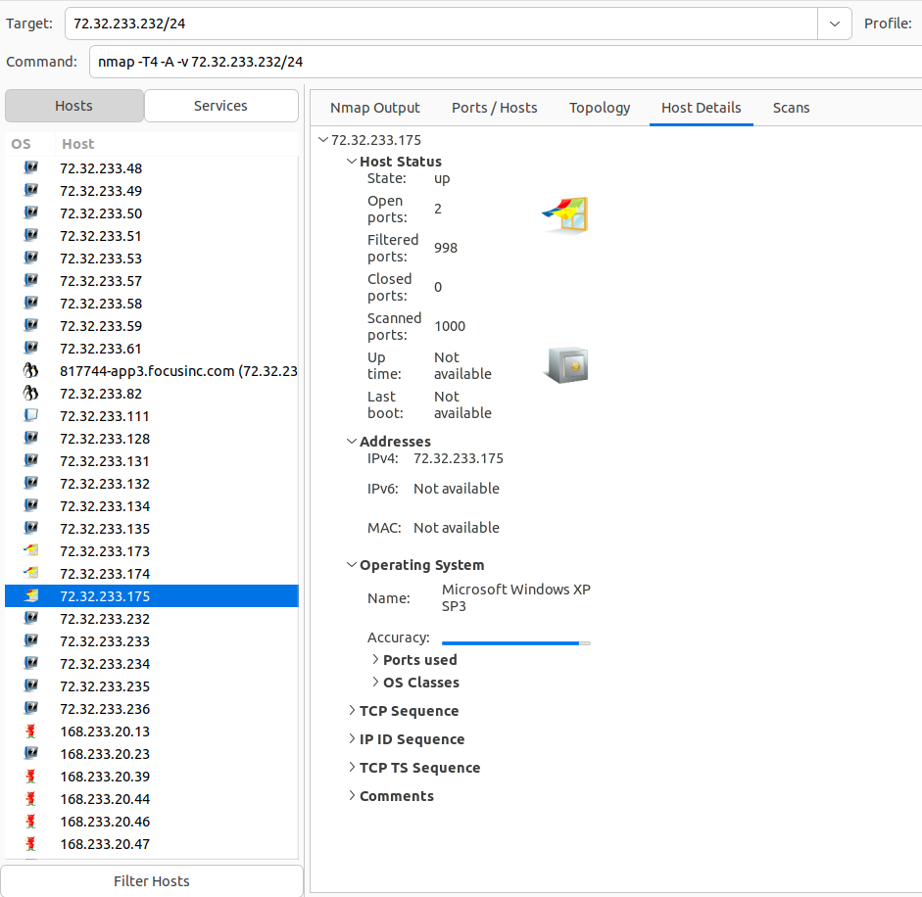
Zenmap Server Pictures - Class A
72.32.233.232

Slide 22
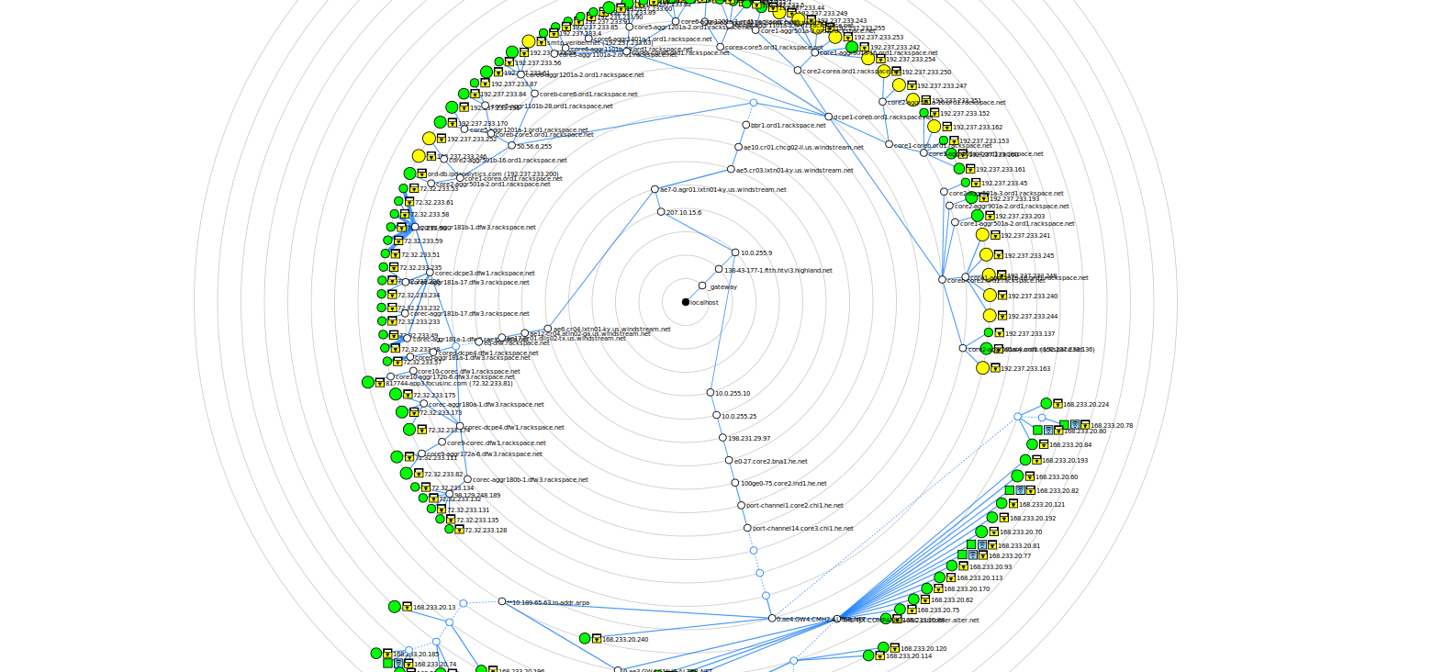
Zenmap Topology

Slide 23
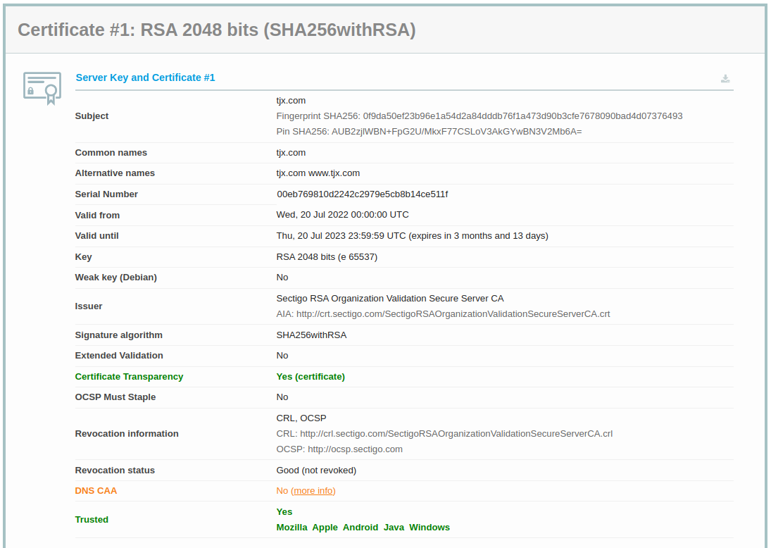
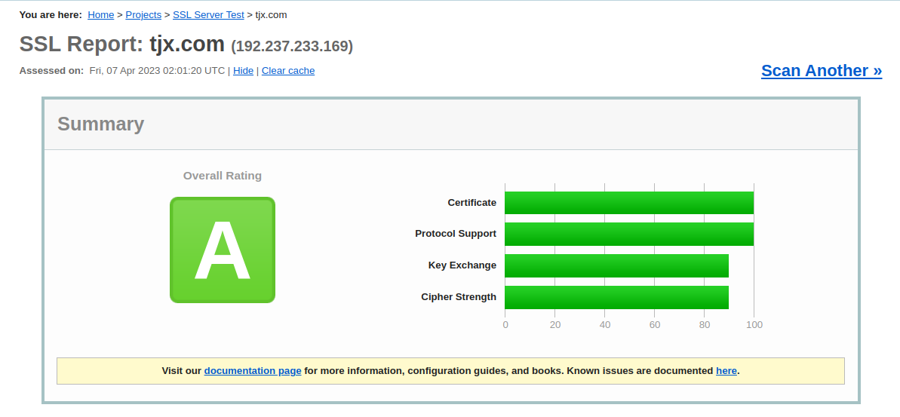
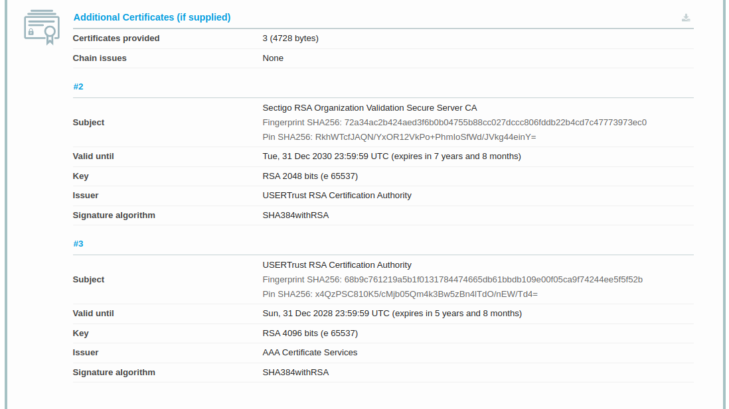
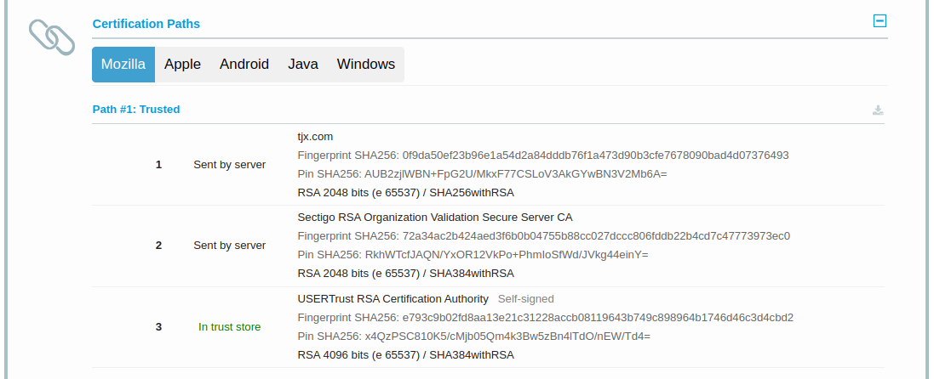
SSL Labs

Slide 24
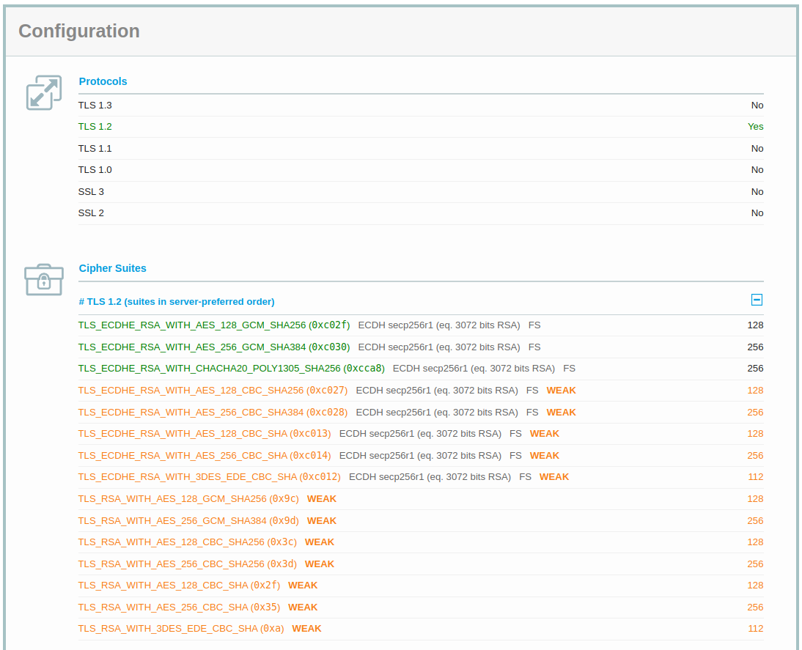
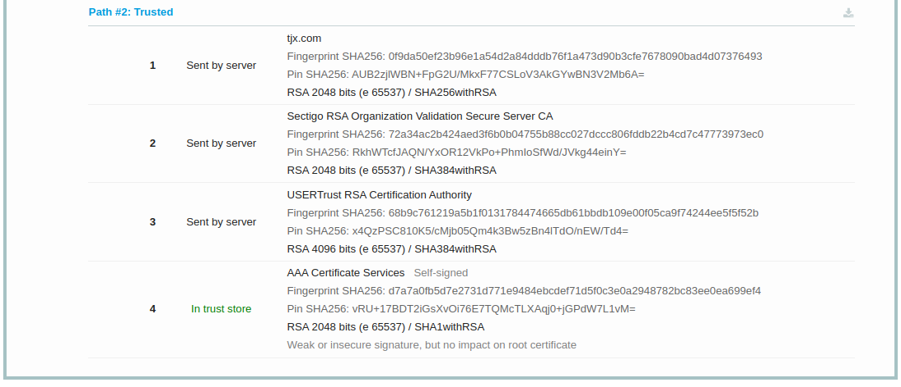
SSL Labs

Slide 25
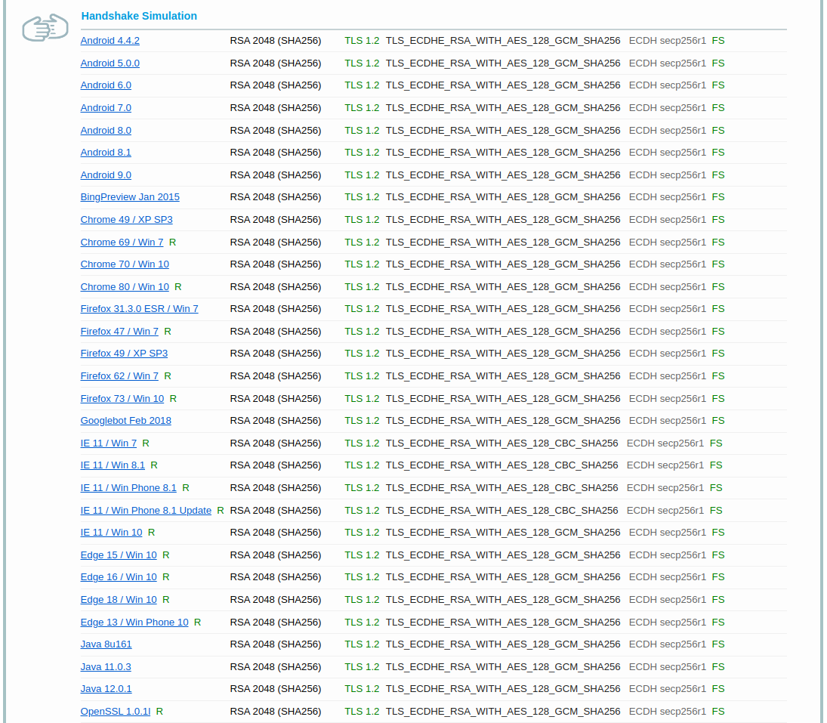
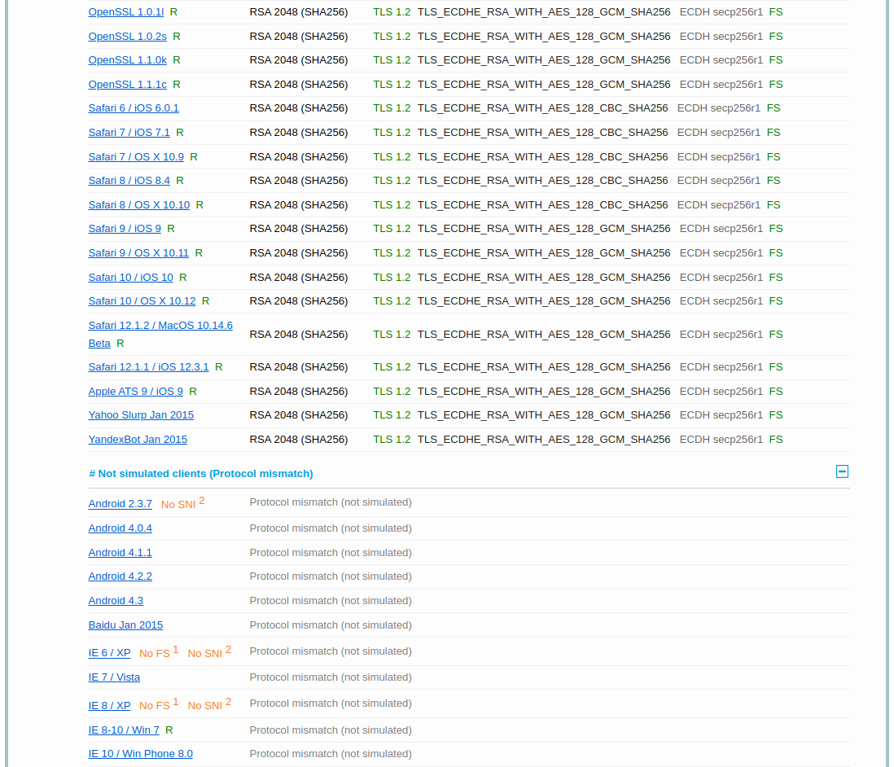
SSL Labs

Slide 26
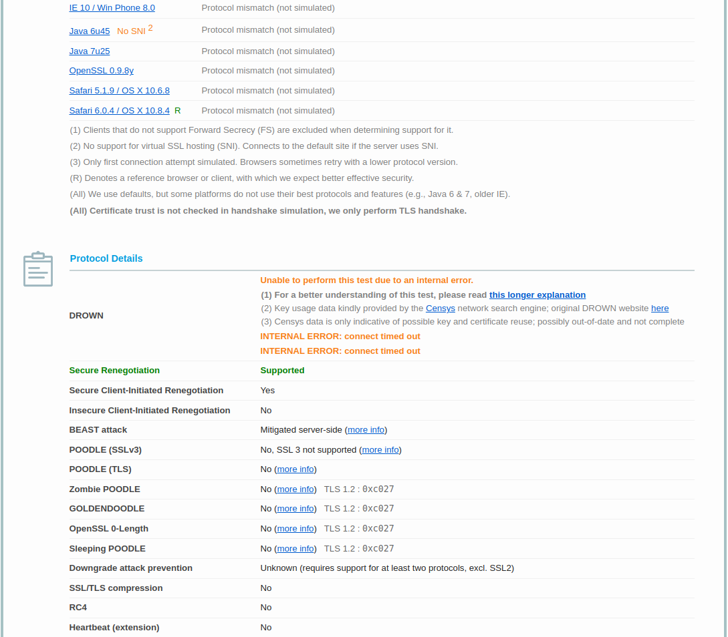
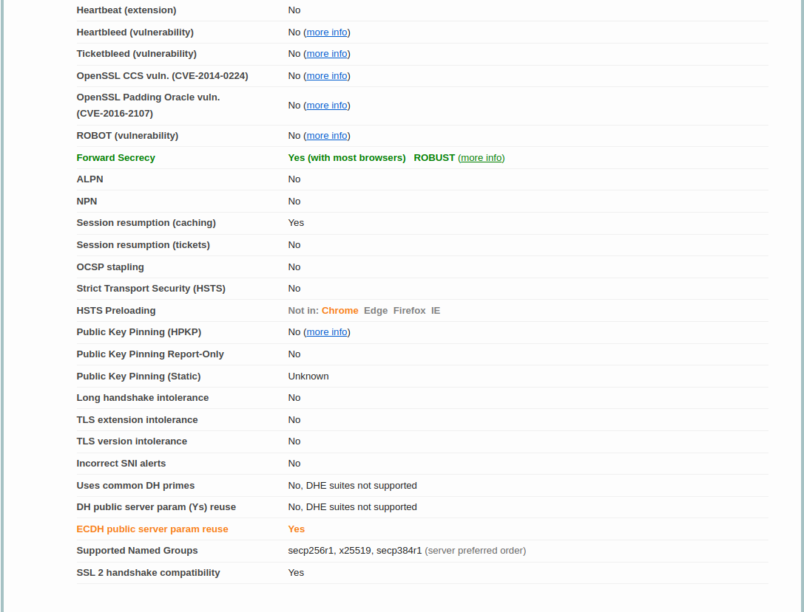
SSL Labs

Slide 27
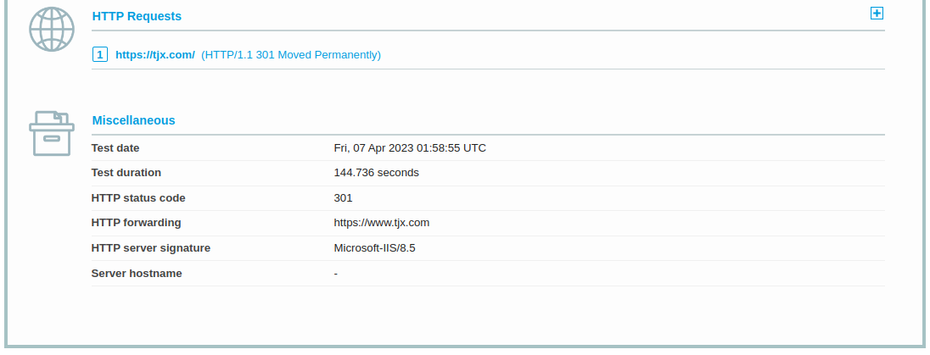
SSL Labs

Slide 28
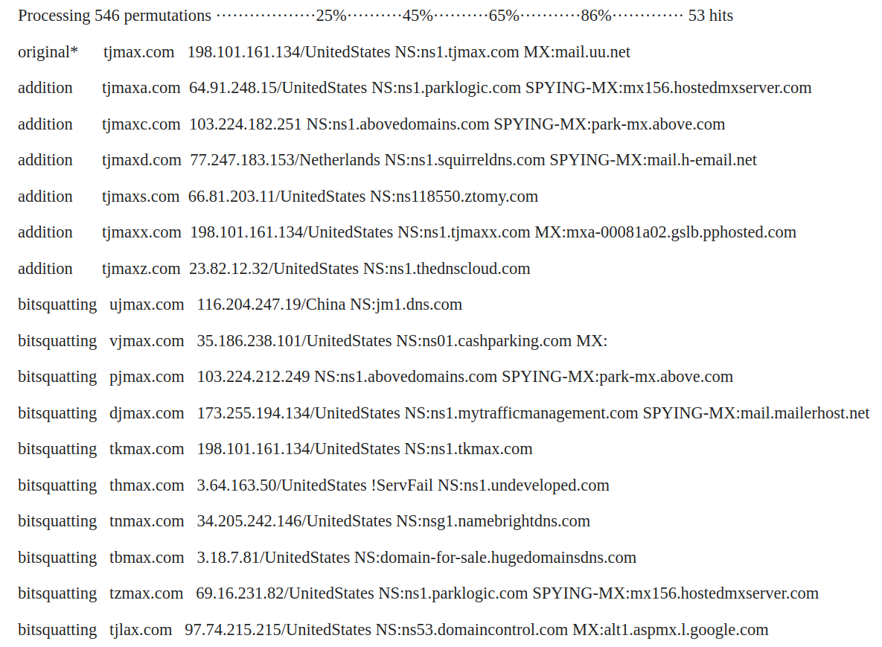
DNS Twist

Slide 29
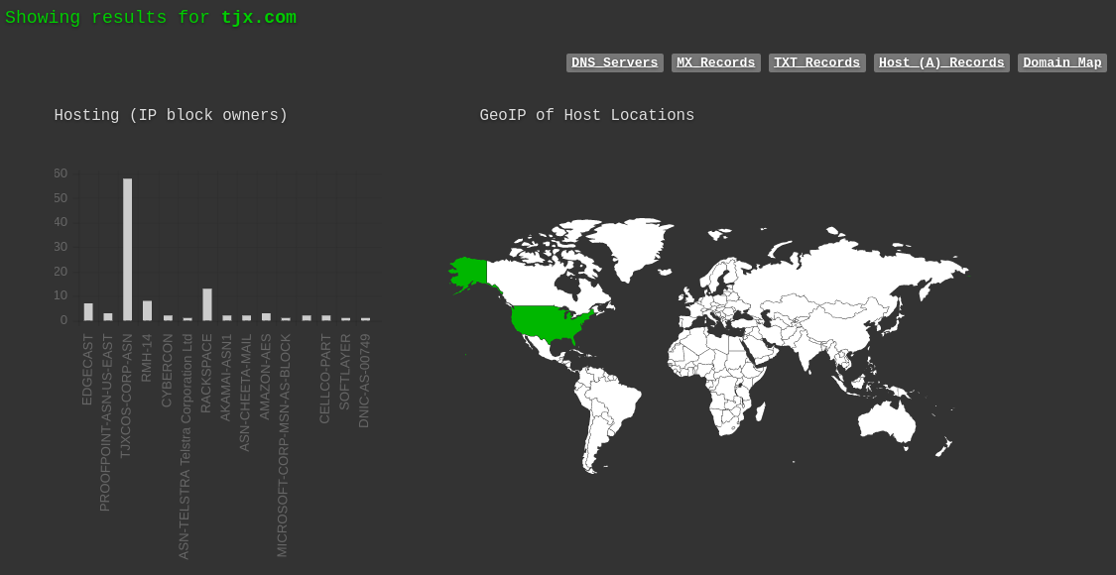
DNSdumpster

Slide 30
DNSdumpster TJX DNS Servers

Slide 31
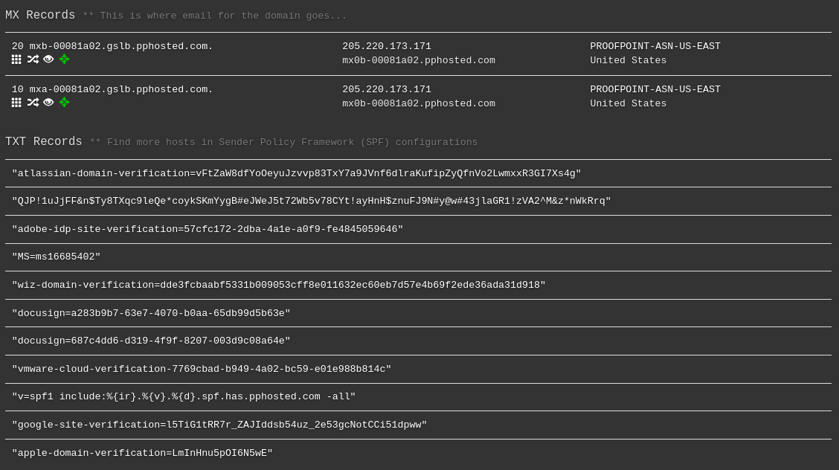
DNSdumpster TJX MX & TXT Records

Slide 32
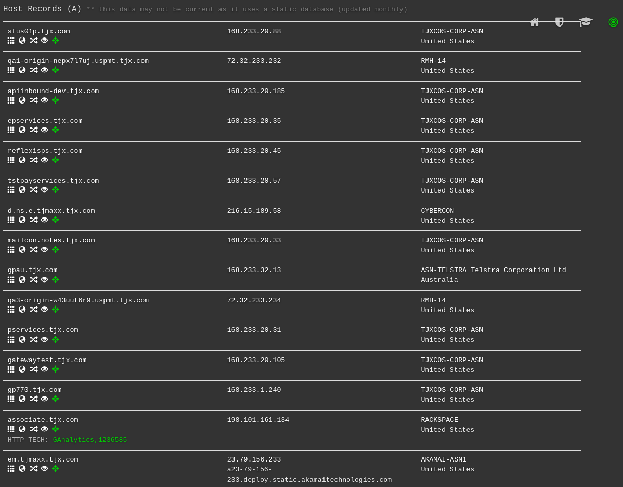
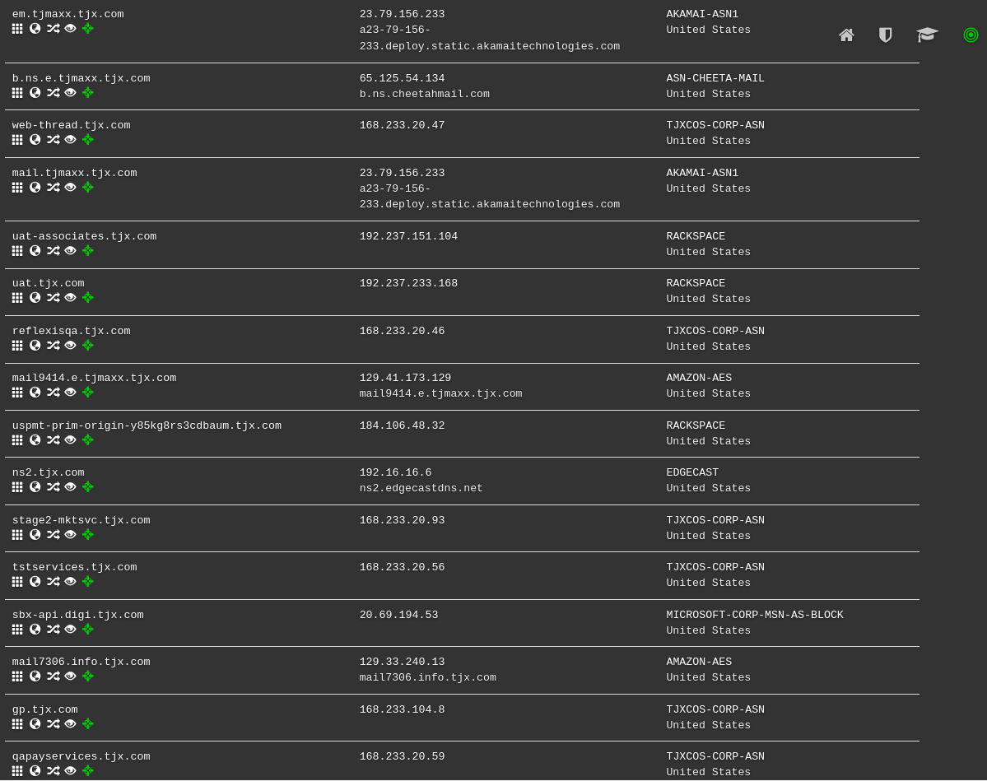
DNSdumpster TJX Host Records

Slide 33
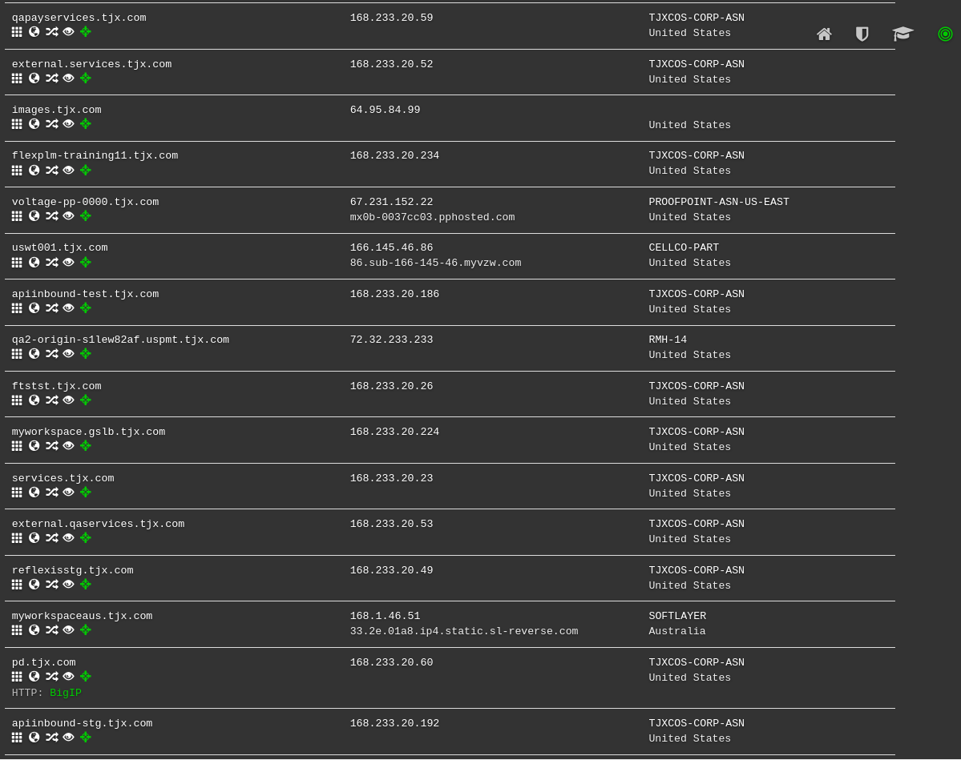
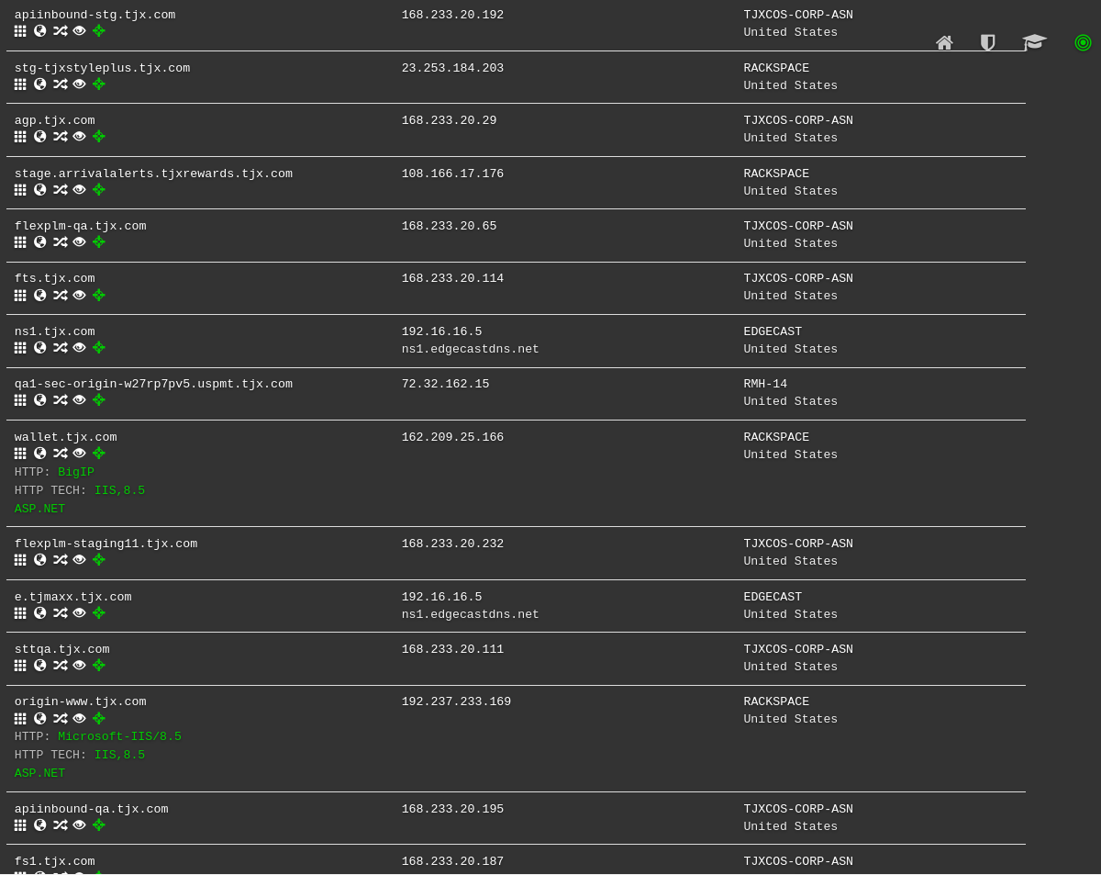
DNSdumpster TJX Host Records

Slide 34
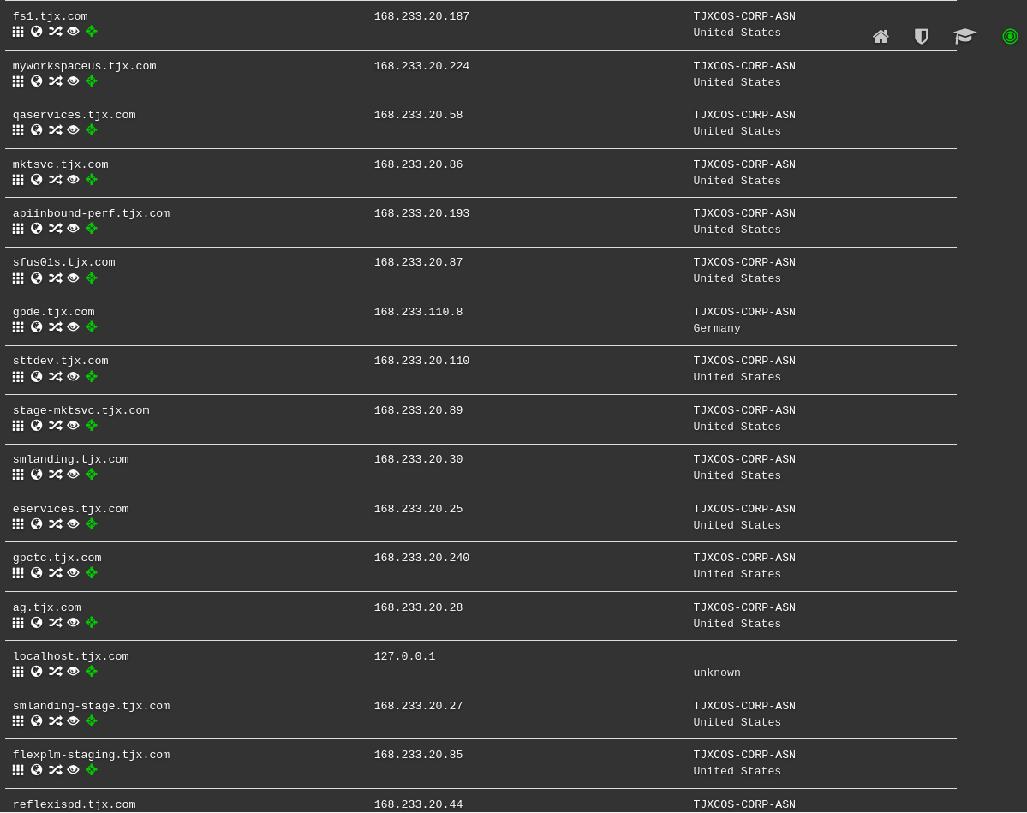
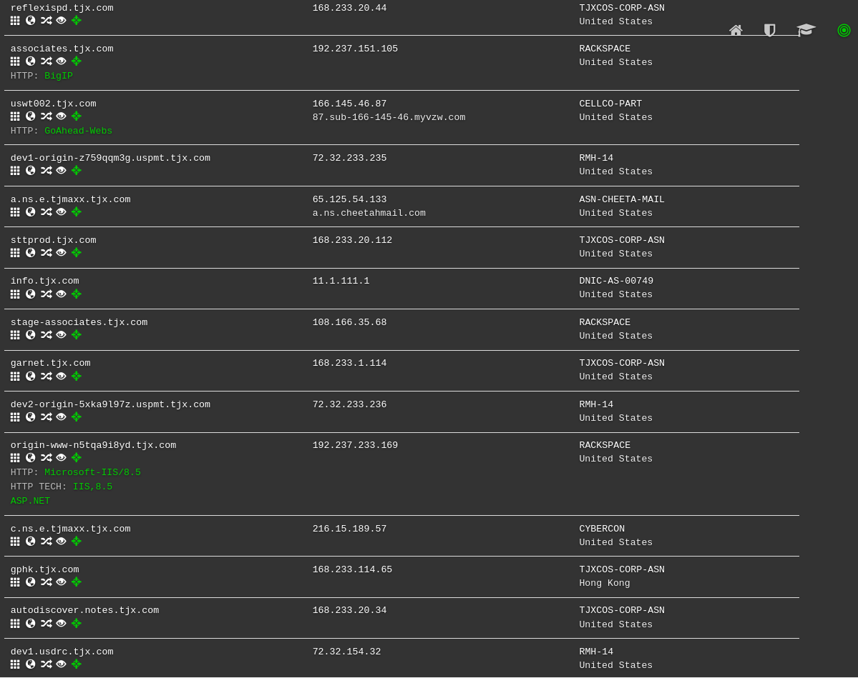
DNSdumpster TJX Host Records

Slide 35
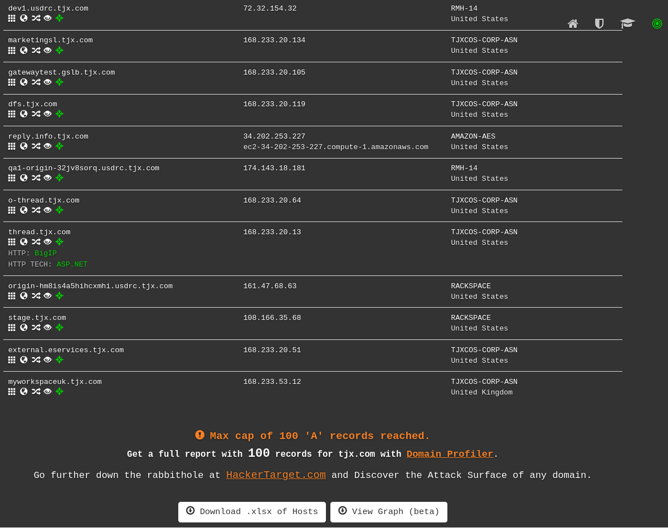
DNSdumpster TJX Host Records

Slide 36
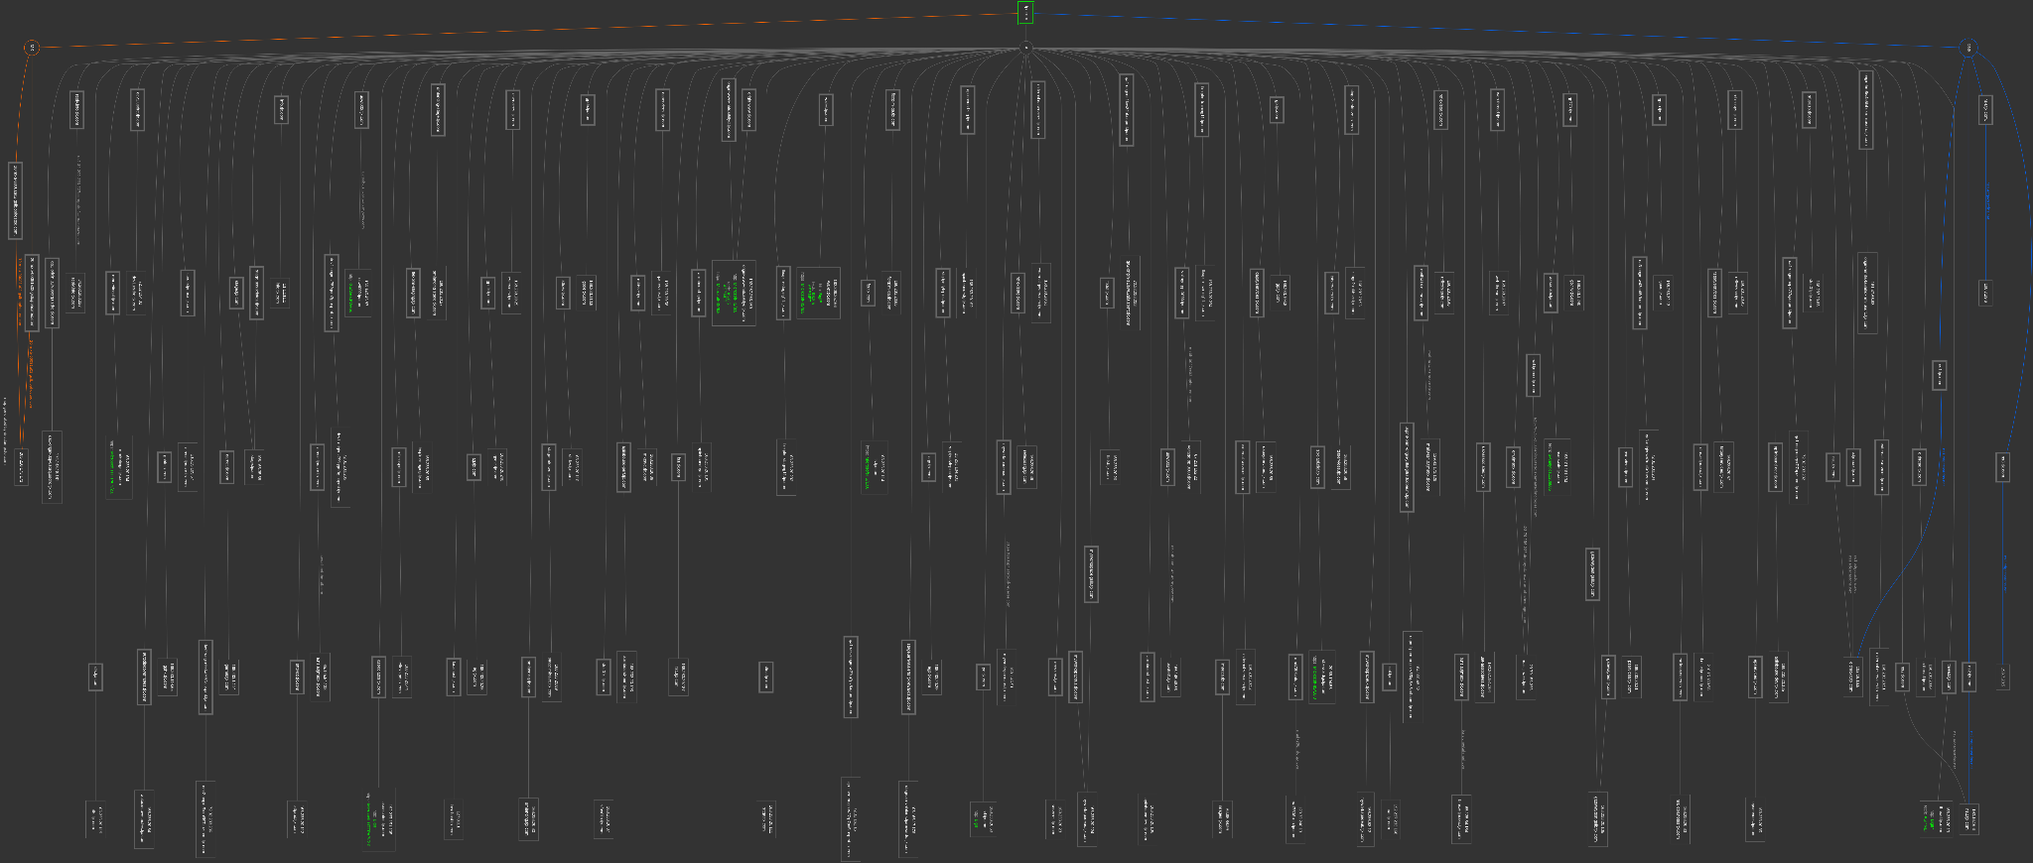
DNSdumpster

