Slide 1
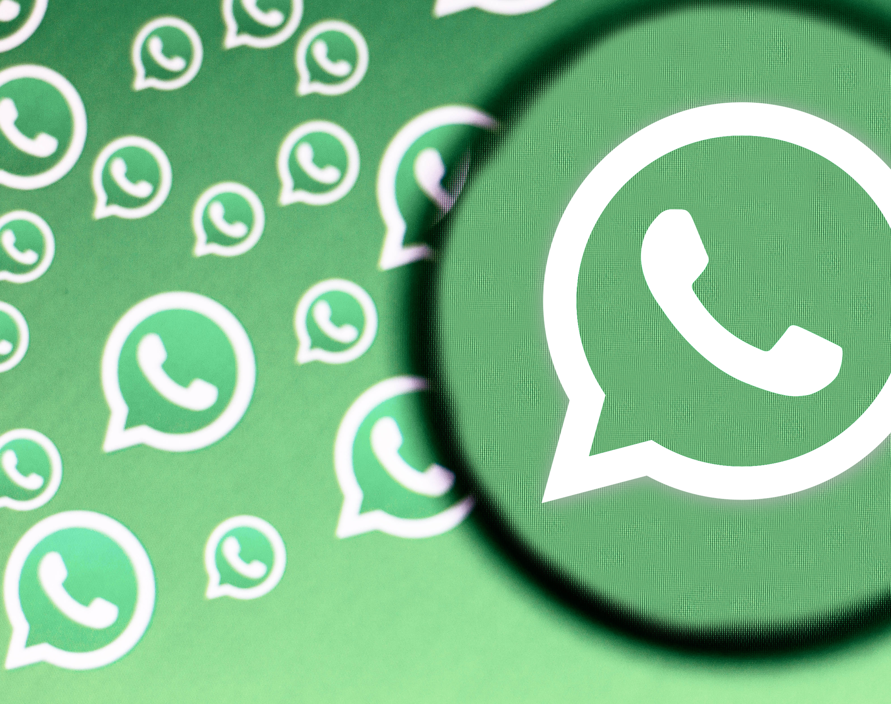
WhatsApp
2022 Security Breach

Slide 3
About WhatsApp
Created in February 2009 by two ex-Yahoo! Employees
Purchased by Meta in October 2014 for around $19 billion
Has more than 2 billion monthly active users

Slide 4
Prior Security Concerns
WhatsApp has had numerous security and privacy concerns over the past decade.
They didn’t offer end-to-end encryption (E2EE) up until 2016, and, even then, they were heavily criticized for using backups that are not covered by E2EE. This meant messages were accessed by third-parties.
In January 2021, WhatsApp announced that they would share user data with Facebook and partnering companies and removed the option to opt out of data sharing. This increases the risk for data to be exploited.

Slide 5
On November 16, 2022, a cyber threat actor posted on dark web forum claiming to sell the personal information of WhatsApp users.
Estimated that 487 million WhatsApp user’s private phone numbers were stolen.
U.S. datasets were sold for $7,000, UK for $2500, and Germany for $2000
It has been reported that the whole data was on sale for four days and is now distributed freely among users of the dark web.
Initial Detection

Slide 6
No messages were stolen or leaked, only phone numbers.
Stolen numbers could be used for phishing, impersonation or fraud.
Seller did not specify how they obtained database, but The information on WhatsApp users could be obtained by harvesting information at scale, also known as API scraping, which violates WhatsApp’s Terms of Service.

Slide 7
Response
WhatsApp, on their part, has completely denied the data breach, stating that “The claim written on Cybernews is based on unsubstantiated screenshots. There is no evidence of a ‘data leak’ from WhatsApp.”
Meta denies there was a data breach, saying only phone numbers were included in the breach, not personal information. Meta also states they have no information on how the list of phone numbers was collected.
As of January 2023, Meta is being fined 5.95 million by Ireland’s Data Privacy Commissioner for being in breach of its obligations in relation to transparency.
In the wake of the WhatsApp data breach, all users must remain alert till the complete scrutiny of data leaked online is done. Maintain caution about the messages, calls and links you may receive on the app.

Slide 8
DNS Dumpster

Slide 9
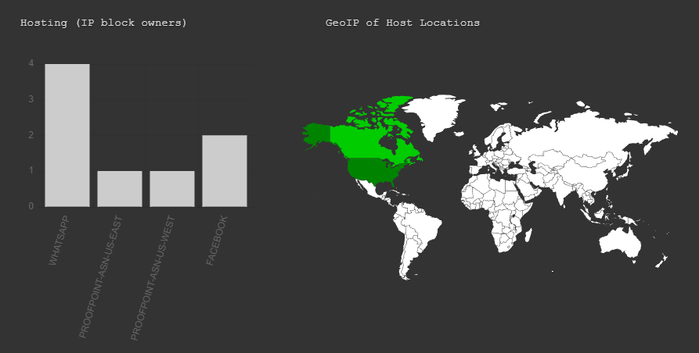

Slide 10
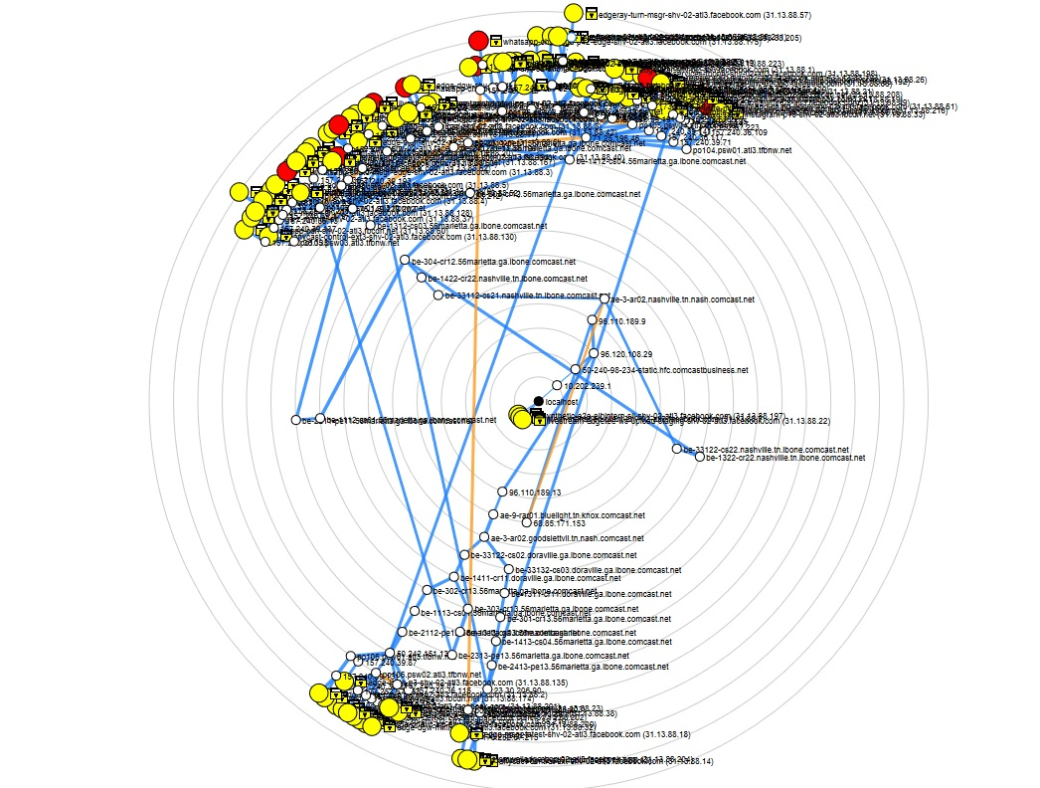
Nmap Scan for whatsapp.com
31.13.88.60/24

Slide 11
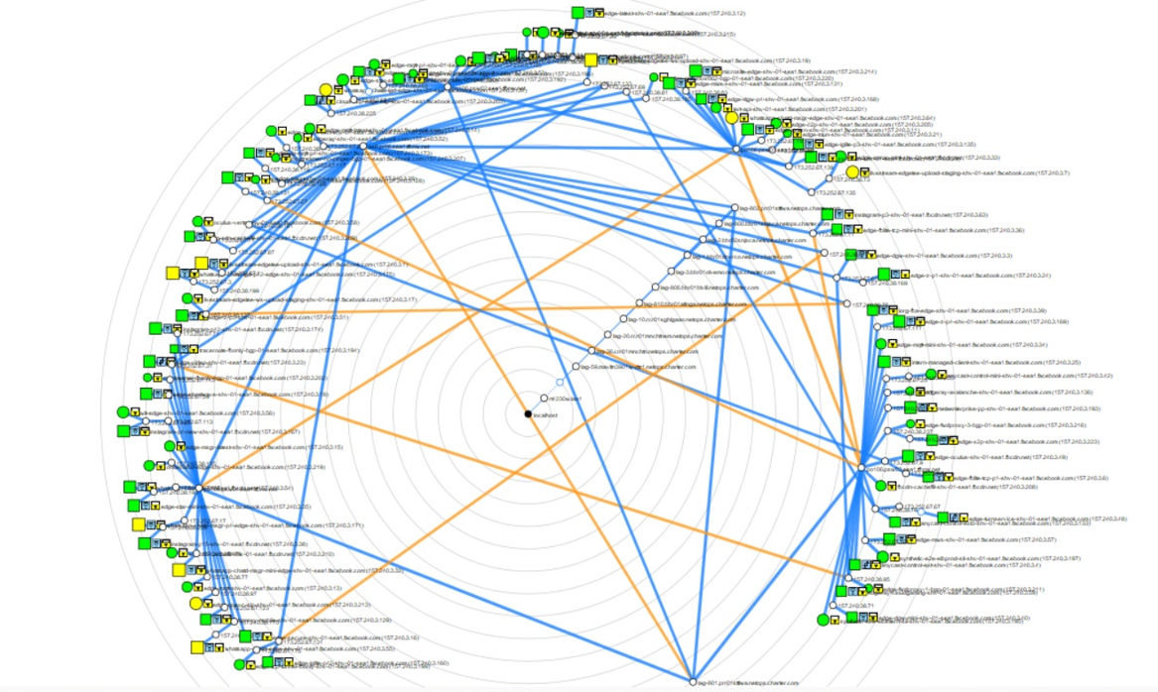
NMap scan for business.whatsapp.com
157.240.3.20/24

Slide 12
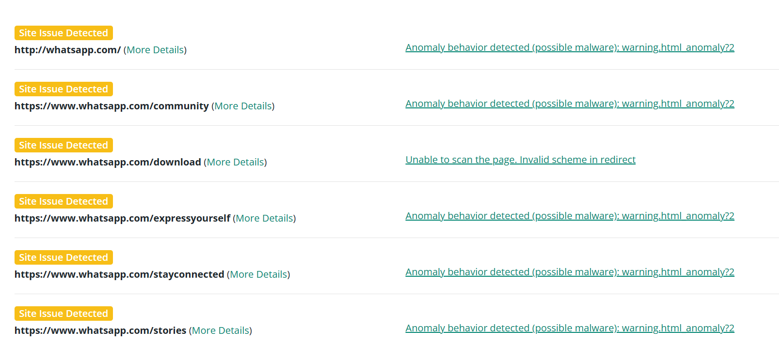
Site Check

Slide 13
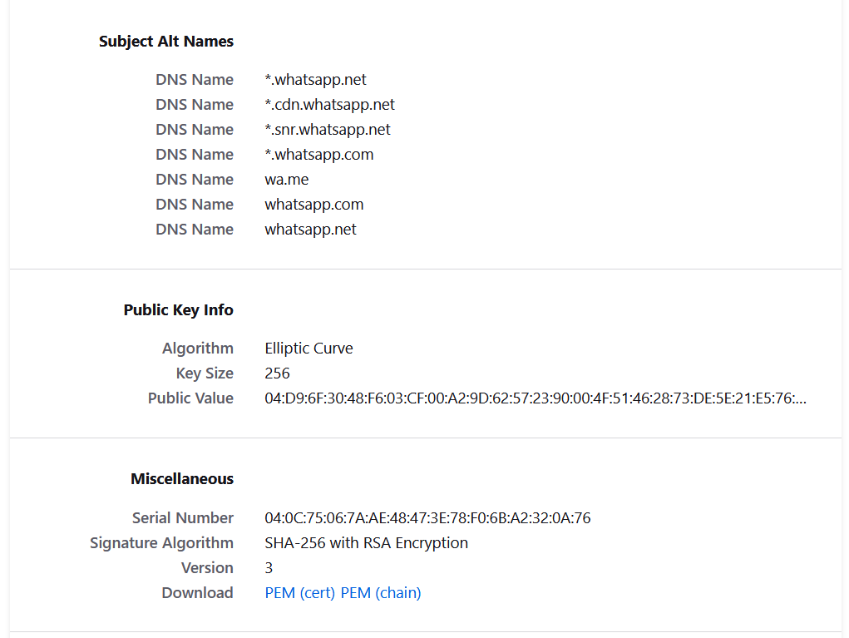
Certificates

Slide 14
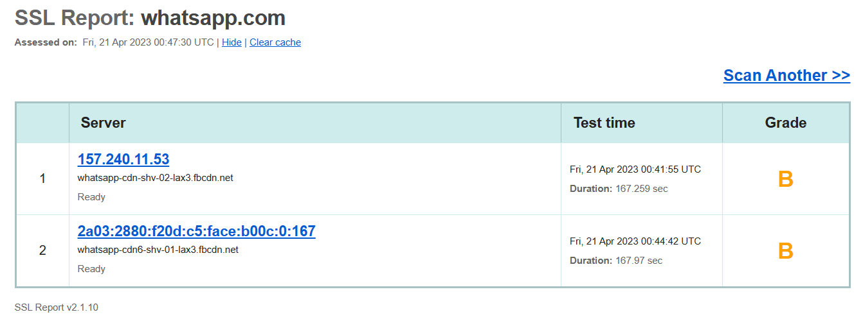
SLL Labs

Slide 15
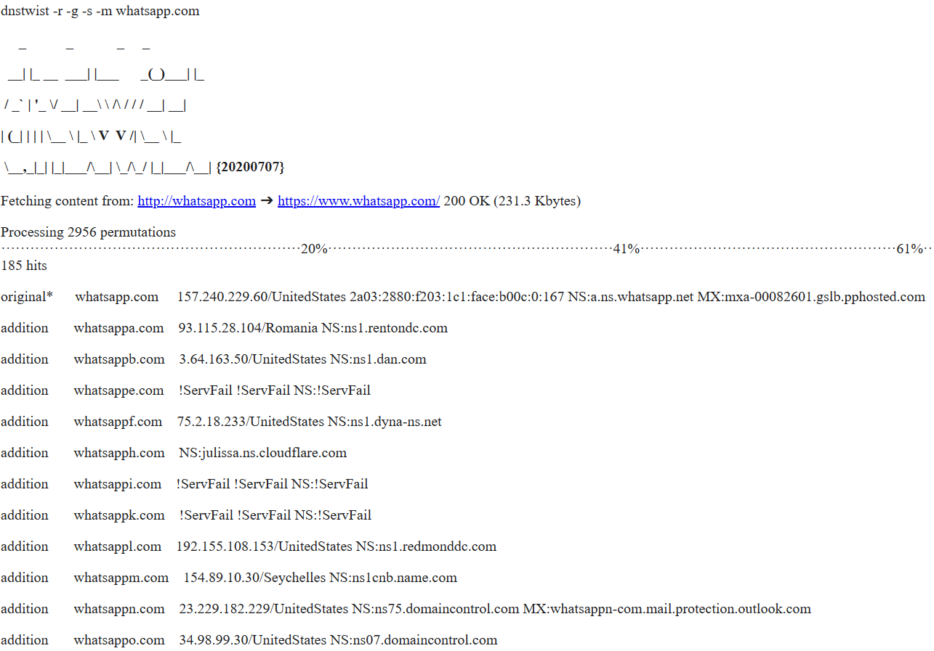
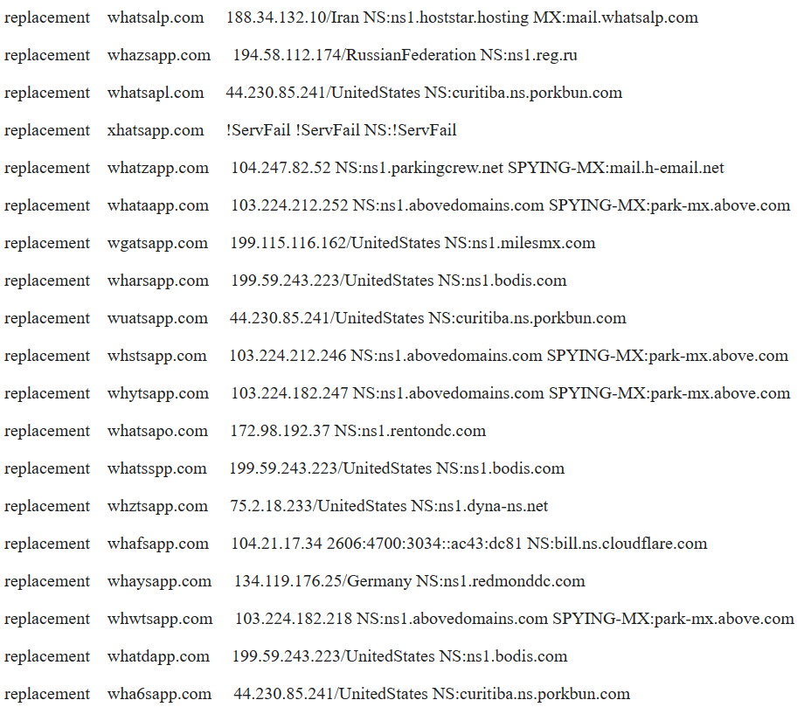
DNSTwist

Slide 16
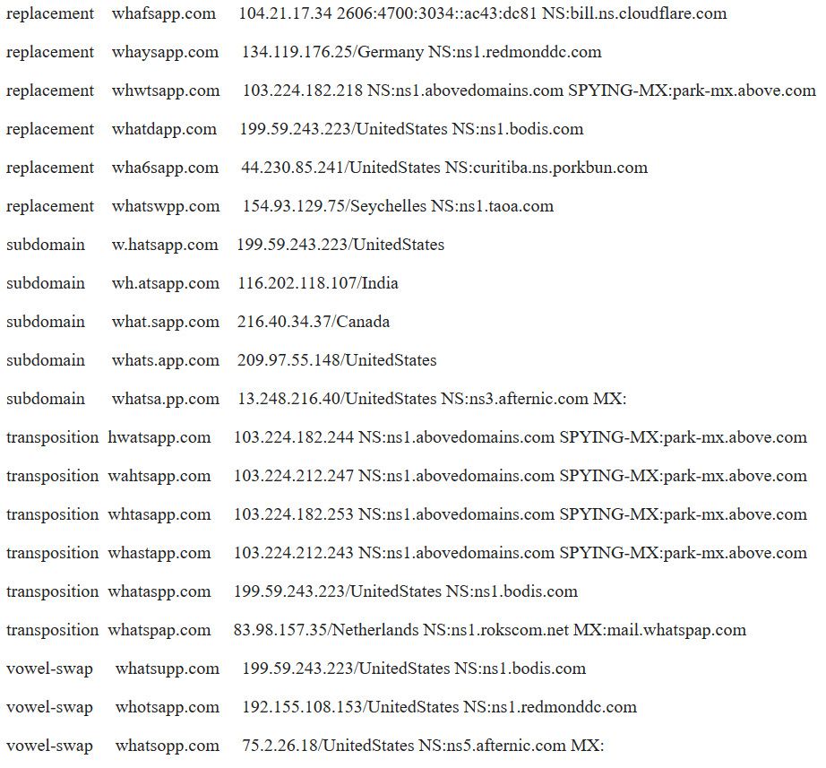
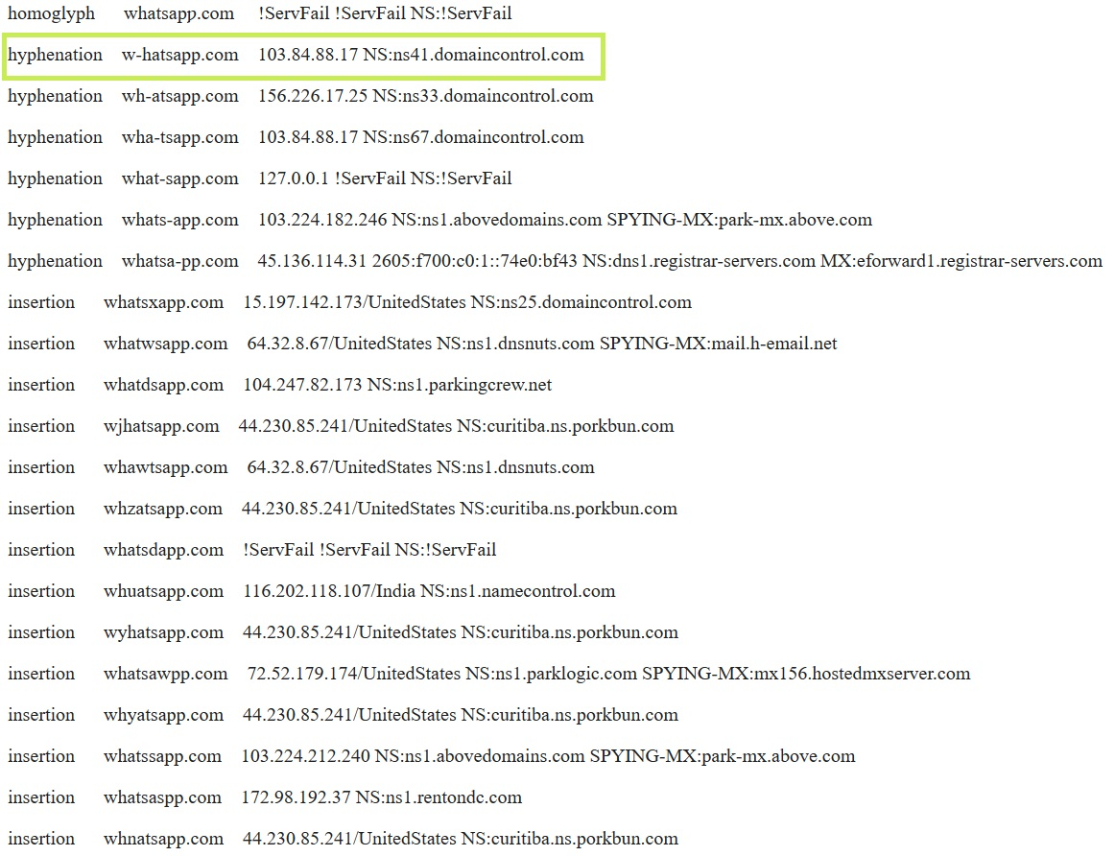
DNSTwist

Slide 17
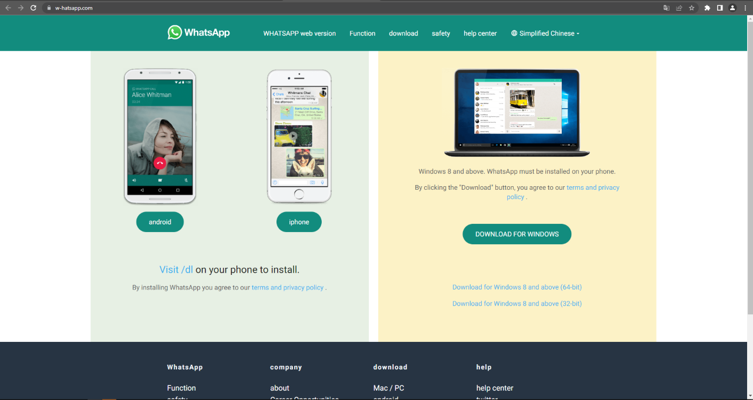
w-hatsapp.com 103.84.88.17 NS:ns41.domaincontrol.com

Slide 18
Sources
LinkedIn https://www.linkedin.com/pulse/whatsapp-data-breach-500-million-users-worldwide-#:~:text=Last%20month%20on%20November%2016%2C%202022%2C%20a%20cyber,includes%20the%20database%20of%20users%20from%2084%20countries.
Tech Radar Pro http://www.techradar.com/news/whatsapp-data-breach-sees-nearly-500-million-user-records-up-for-sale
Cyber News http://cybernews.com/news/whatsapp-data-leak
Tech Times http://www.techtimes.com/articles/284024/20221127/whatsapp-massive-data-breach-secure-account-here-tips.htm
Top Class Actions http://topclassaction.com/lawsuit-settlements/privacy/data-breach/whatsapp-data-breach-reportedly-leaks-info-of-500-million-users/

